Slide 1
Aachen, 24.06.2024
Burkardt, Lehrheuer
Proposal for FSC²
How to use Overleaf
Internal documentation

Slide 2
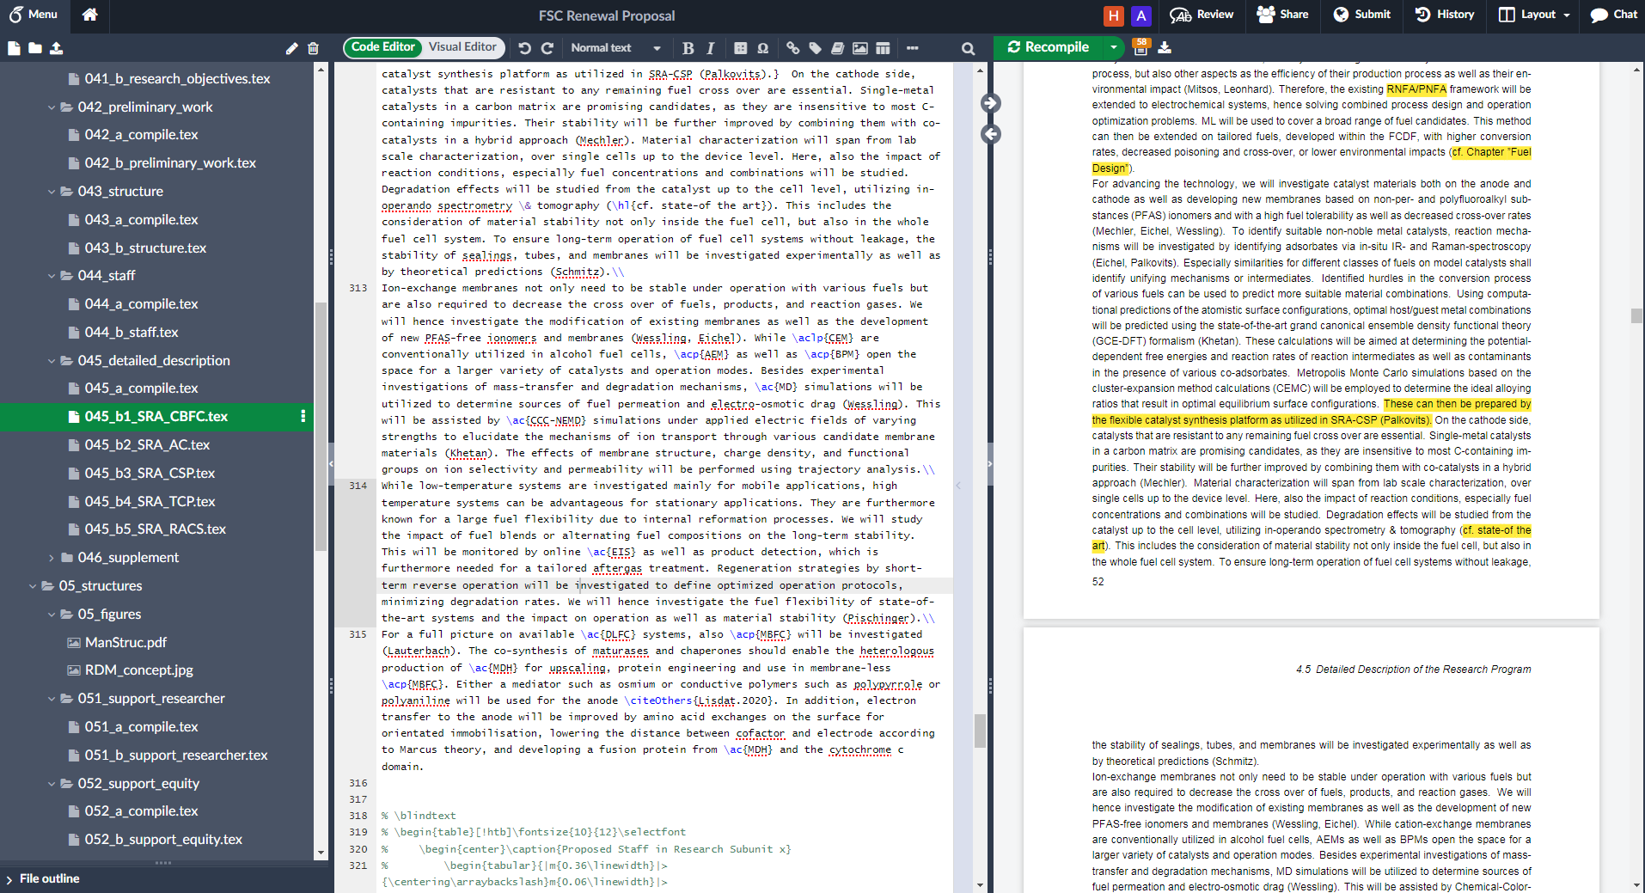
Overview
Writing section
Structure:
single tex files,
figures
PDF

Slide 3
Where to write
Type in text
Compile to see PDF
Select file
you want
to work in

Slide 4
Special comments
“&”, “%”, “_” require “\” before the symbol
to use the symbol as the symbol itself
“\hl{…}” causes yellow highlighting of text in {}
“\\” at the end of a line causes end of paragraph
Use of acronyms (e.g., ICE):
“\ac{…}” Latex decides by itself
“\acs{…}” → ICE
“\acl{…}” → internal combustion engine
“\Acl{…}” → Internal combustion engine
“\acf{…}” → internal combustion engine (ICE)
“\acsp{…}” → ICEs
“\aclp{…}” → internal combustion engines
“\pp{…}” colors text in RWTH blue
“%” at beginning of line causes that
this line will not be shown in PDF

Slide 5
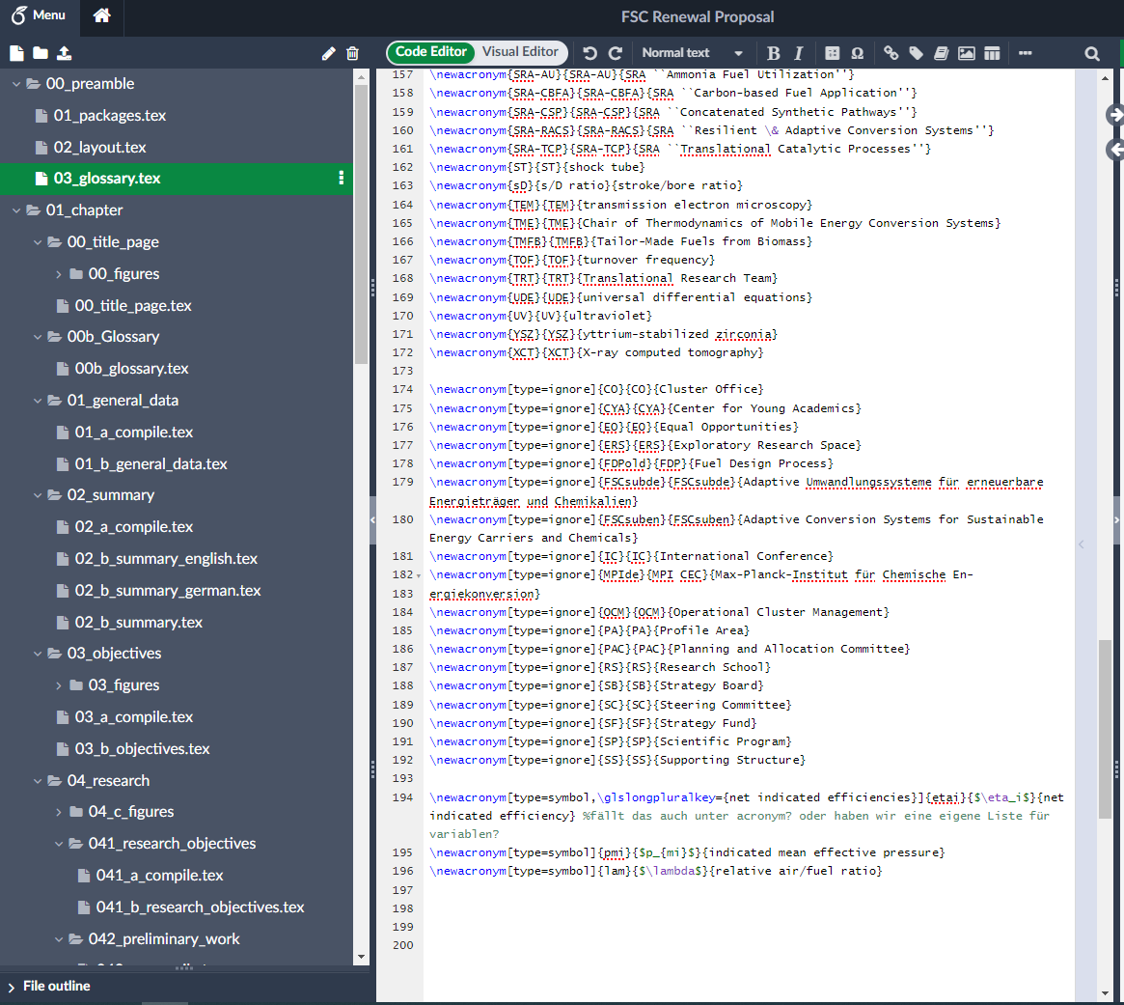
Acronyms (alphabetic order)
Definition of
acronyms
“normal” acronyms
Acronyms that will not be printed
in the list of acronyms
Symbols

Slide 6
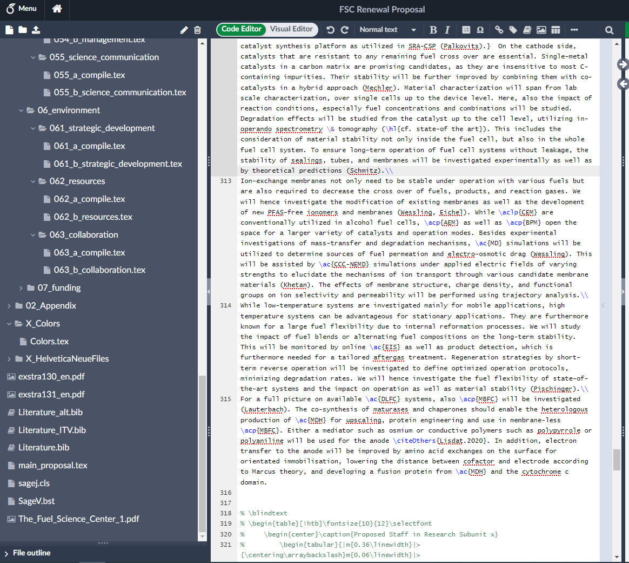
Literature
bib file created
from Citavi
“\citeCluster{…}” → with cluster acknowledgement
“\citePI{…}” → PI publications without cluster
acknowledgement
“\citeOthers{…}” → all other publications

Slide 7
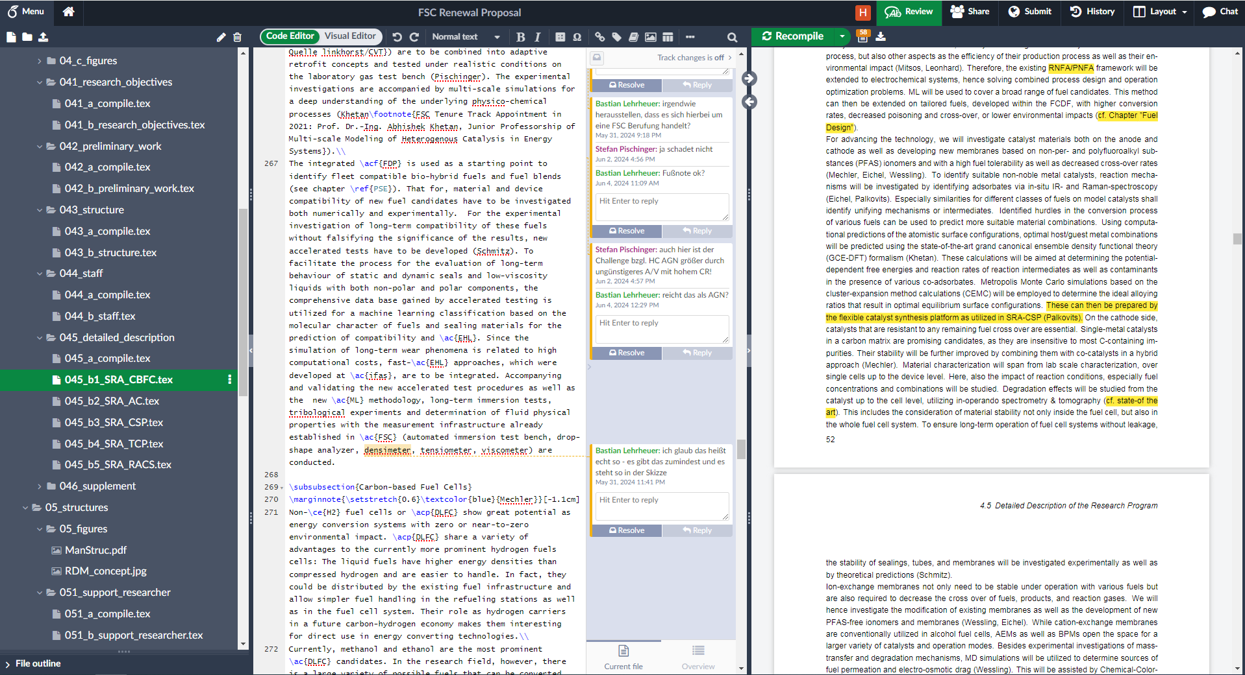
Commenting
Comment section
Click for comment section

Slide 8
Spelling and grammar
American English, not British English
Toward, not towards
Unburned, not unburnt
Use of Oxford comma in a series of three or more terms: first, second, and third; green, red, or blue
Comma after e.g. and i.e.: e.g., …; i.e., …
Ammonia, hydrogen, nitrogen, etc. are not capitalized
FSC vs the FSC

