Slide 1
The Integrated
Fuel & Chemical
Science Center
Adaptive Conversion Systems for Sustainable Energy Carriers and Chemicals
Renewal Proposal EXC2186

Slide 2
Confidential!
We kindly ask that all content shared in this meeting be treated with the utmost confidentiality. Your cooperation is greatly appreciated.
If anyone feels a conflict due to another cooperation or obligation, we respectfully ask you to excuse yourself from this session.

Slide 3
Guiding Questions for the Discussion
1. Are the Vision & Mission Well-Articulated?
  Does the mission statement of the research program clearly define its goals and purpose?
  Are the objectives of the research program aligned with the overall mission and vision?
2. Is the Structure of the Research Program Sound?
  Do the Strategic Research Areas (SRAs) provide a logical and coherent structure that supports our goals?
  Are the different components of the program well-integrated and do they effectively contribute to the overall success?
3. Is the Research Initiative Sufficiently Motivated?
  Have we provided a strong and compelling rationale for the research initiative?
  Do the proposed research questions address significant gaps or needs in the current knowledge?
4. Are There Any Creative and Innovative Suggestions for Supporting Activities?
  What additional strategies can we employ to enhance the visibility and impact of the research program through public engagement and outreach?
  How can we improve our efforts in nurturing young talent and fostering the next generation of researchers within the program?
  Are there innovative approaches to knowledge transfer and collaboration that we should consider incorporating into our activities?

Slide 4



Global greenhouse gas emissions by sector 2019
Update figures
49.76
Gt/a
CO₂eq
Notes:
https://ourworldindata.org/emissions-by-sector

Slide 5
Global greenhouse gas emissions by sector 2019
75.6 %
Energy
14.9 %
Agriculture, Forestry & Land Use
Update figures
50.1
Gt/a
CO₂eq
3.3 %
Waste
6.1 %
Industry
Transport
17.0%
8.4
Gt/a
CO₂eq

Slide 6
Global greenhouse gas emissions by sector 2019
75.6 %
Energy
14.9 %
Agriculture, Forestry & Land Use
49.76
Gt/a
CO₂eq
3.3 %
Waste
6.1 %
Industry
Transport
17.0%
8.4
Gt/a
CO₂eq
Chemistry?

Slide 7
Vision
Scalability, Hybridizability, Variability, Resilience
Closed Material Cycle
Near-to-zero Environmental Impact
Bio-hybrid
Fuels & Chemicals
Renewable Power
&
Feedstocks
Production
&
Propulsion
Adaptive Conversion Systems
The Integrated Fuel & Chemical Science Center
IAB Meeting | Aachen | 13.06.2024 | confidential

Slide 8







Mission
Renewable Power & Feedstocks
FSC Systems
Bio-hybrid Fuels & Chemicals
FSC Technologies
CO₂
Energy
N₂
NH₃
CH₃OH
e⁻
Energy & Chemistry Interfaces
Chemistry
e⁻
-(CH2)-
H₂

Slide 9
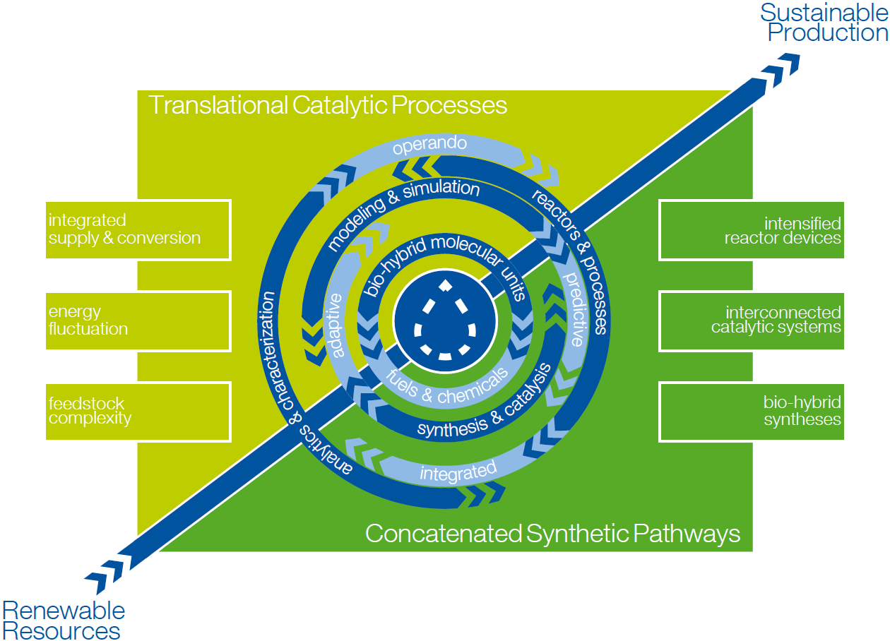
CH₃OH
N₂
NH₃
e⁻
Scientific Objectives - Production
Exploration of chemo-, bio- and electro-catalytic pathways for the selective formation of C-H, C-C, C-O, and C-N bonds from renewable resources with the aim to integrate the individual transformations into optimized synthetic pathways for fuels and chemicals (concatenation) and their validation in view of feedstock variation and energy fluctuation in post-fossil value chains (translation).
Advancing the toolbox in experiment and theory for the investigation of complex catalytic reactions and processes to derive design principles from the molecular to the process level as input for and in response to the interdisciplinary analysis in the Fuel & Chemical Design Forum.
CO₂
e⁻
H₂
-(CH2)-

Slide 10
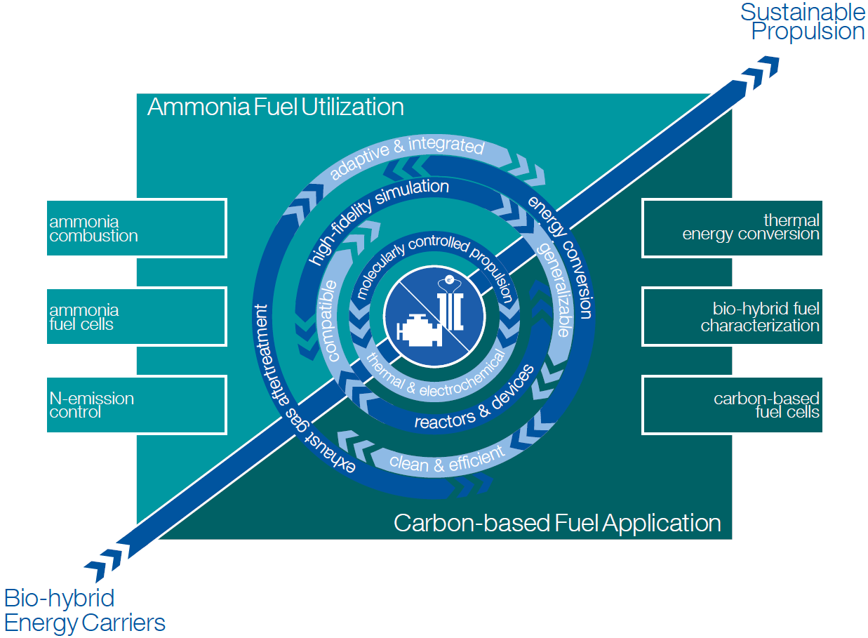
Scientific Objectives - Propulsion
Mitigate carbon emissions from existing vehicle fleet by developing bio-hybrid fuel based molecularly-controlled engine concepts that can be retrofitted to existing combustion systems enabled through advanced technologies for combustion and aftertreatment systems with energy conversion efficiencies beyond 50 % and near-zero pollutant emissions.
Develop carbon- and ammonia-based fuel cell concepts and ammonia-fueled combustion engines for new passenger vehicles, heady-duty, and marine applications enabled by fundamental understanding of the involved thermochemical and electrochemical processes

Slide 11
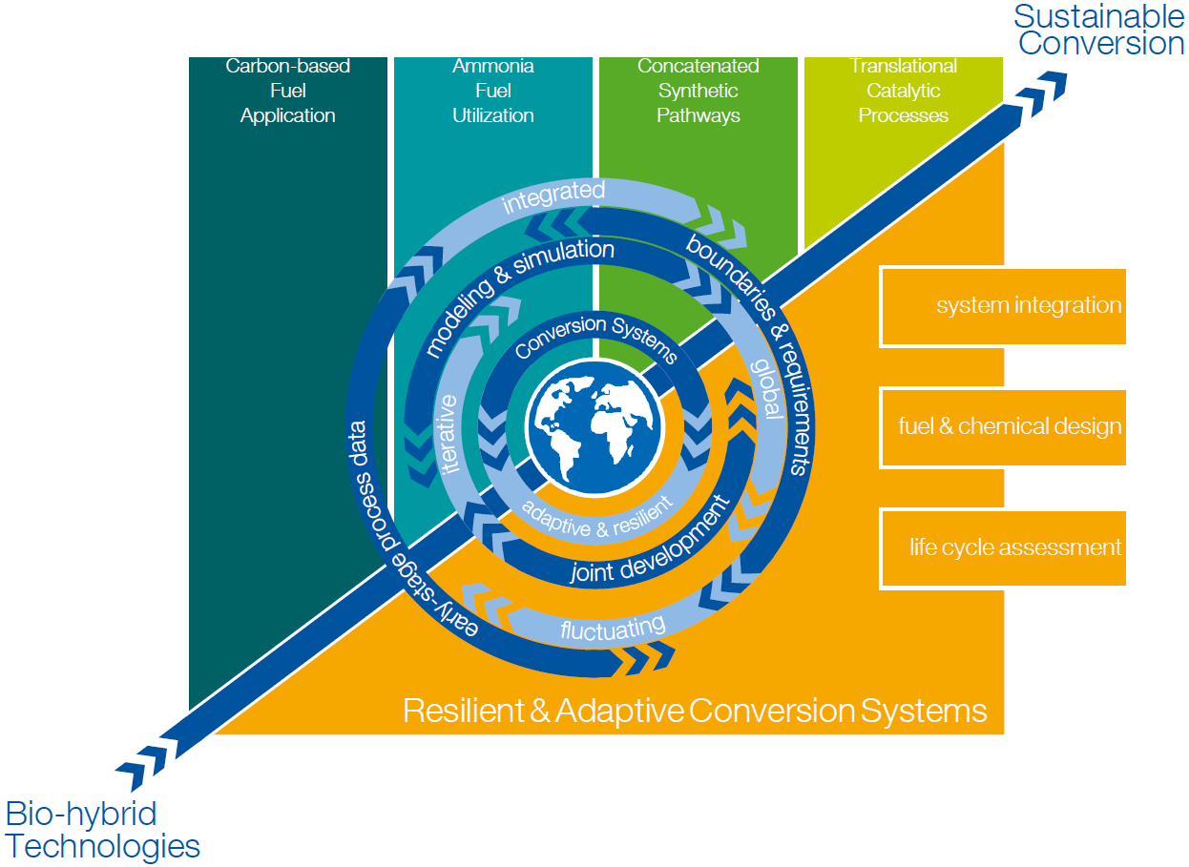
Scientific Objectives - System
System integration of the developed fuels, processes and pathways is enabled by interdisciplinary assessment and optimization of resilient and adaptive intersectoral conversion systems based on systemic risks, stakeholder perspectives, policies and sustainability criteria.
The fuel and chemical design optimizes the overall conversion performance, accounting for fleet-compatible and novel propulsion concepts and co-production of chemicals and fuels; this is done by developing and employing cutting-edge methods from propulsion equipment design, production process development, and machine learning.

Slide 12
Structure of the Research Program:
Strategic Research Areas Extend Across all Competence Areas
Carbon-based Fuel
Application
Ammonia Fuel Utilization
Concatenated
Synthetic
Pathways
Translational Catalytic Processes
Resilient & Adaptive Conversion Systems
Propulsion
Production
Competence Area 1:
Molecular Transformations & Interactions
Bio-hybrid Fuel Characterization
N-emission Control
Interconnected Catalytic Concepts
Feedstock Complexity & Variability
Carbon-based
Fuel Cells
Ammonia Combustion
Bio-hybrid Synthesis
Competence Area 2:
Interfacial Phenomena & Devices
Energy Input & Fluctuation
Thermal Energy Conversion
Ammonia Fuel Cells
Integrated Reactor Systems
Integrated Feedstock Supply & Conversion
Fuel & Chemical Design
System
Competence Area 3: Fuel Design & Sustainable
Cross-sectorial
Value Chains
Integration
Life Cycle Assessment
Fuel & Chemical Design Forum

Slide 13
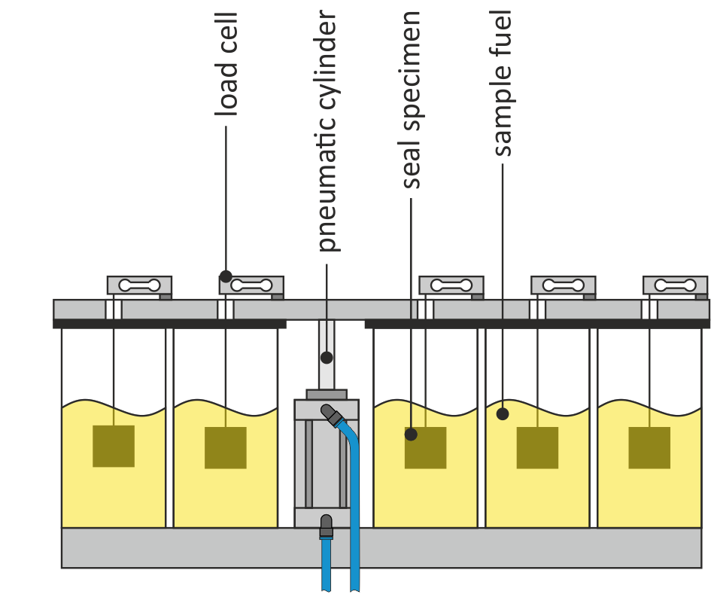
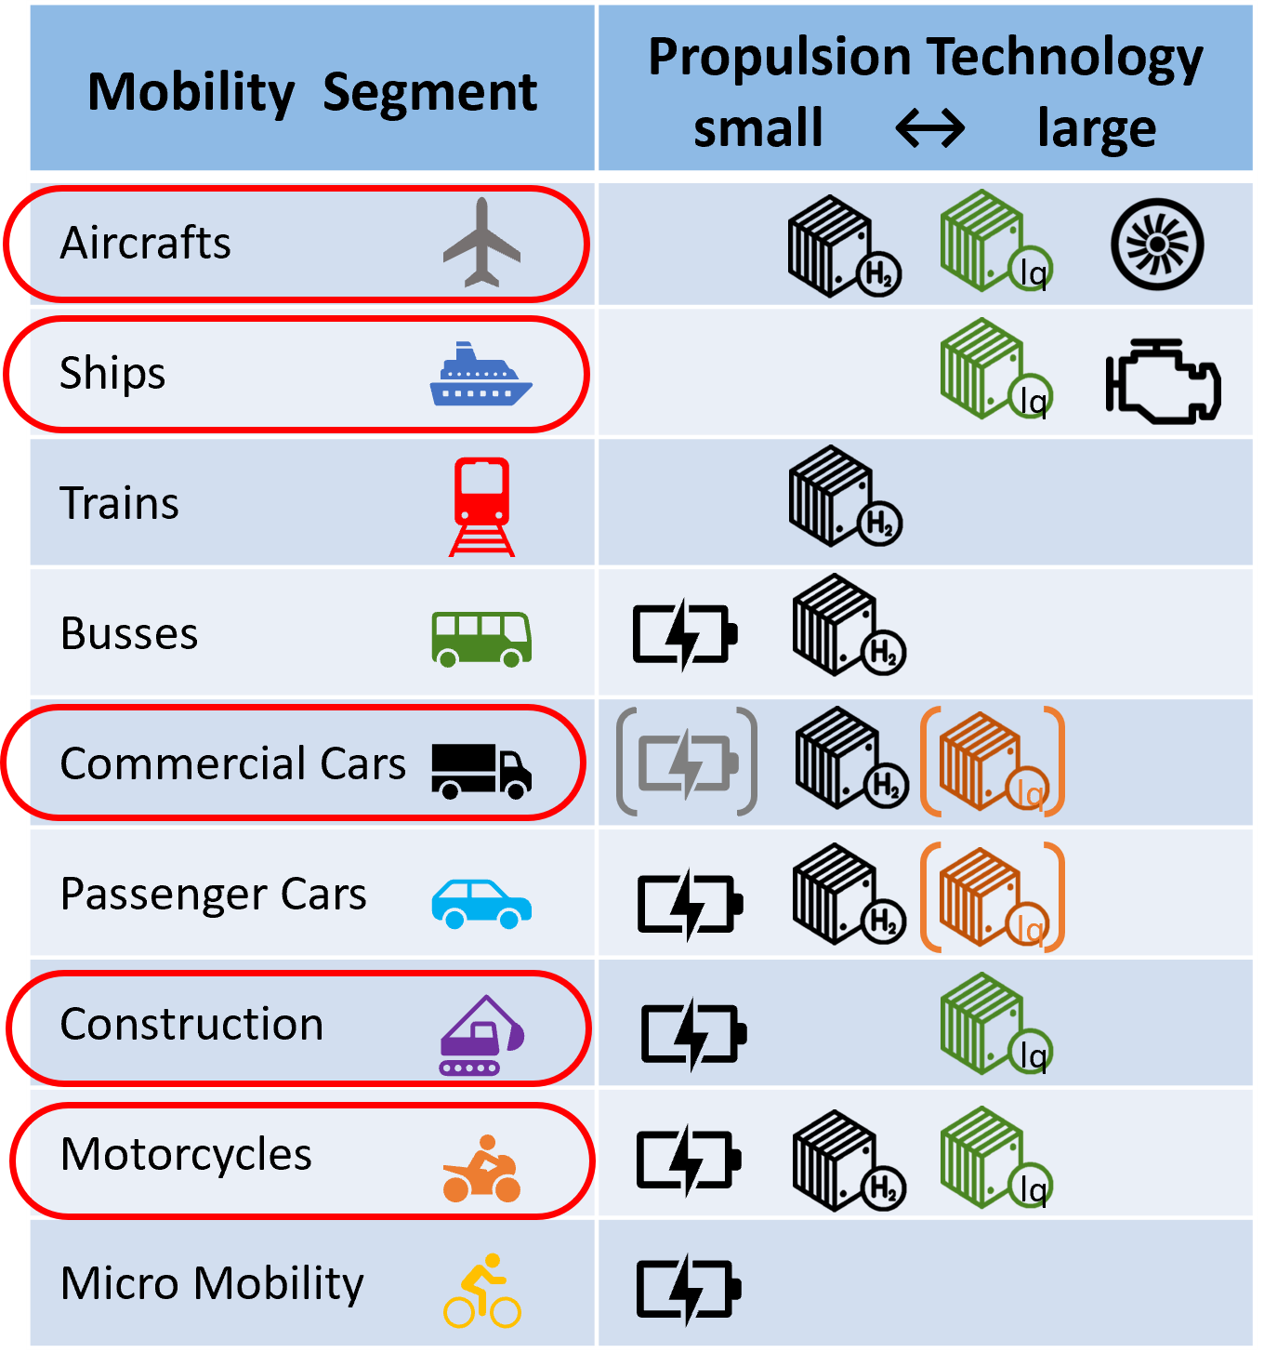
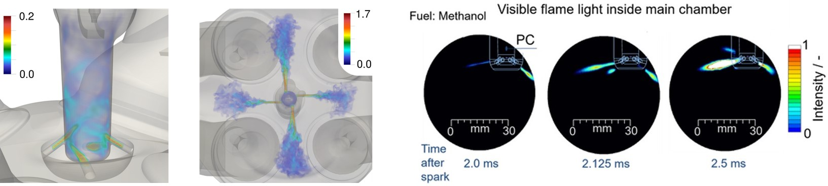
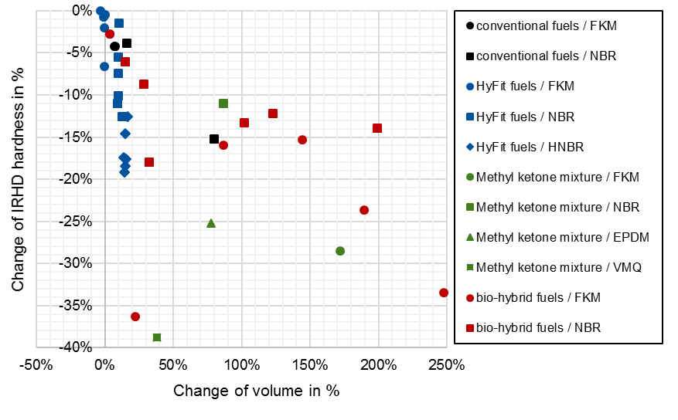
Strategic Research Area I: Carbon-based Fuel Application
Molecularly Controlled Propulsion Systems
Carbon-based Fuel
Application
Molecularly Controlled Combustion
  molecular torch & spark
  in-cylinder coating
  adaptive exhaust gas aftertreatment
Fuel & Device Compatibility
  combustion characteristics
  tribology & elastohydrodynamics
  long-term behavior
  via accelerated testing & simulation
Fuel Cell Technologies
  low- & high-temperature
  flex-fuel
  dynamic operation
Bio-hybrid Fuel Characterization
Carbon-based
Fuel Cells
Thermal Energy Conversion

Slide 14
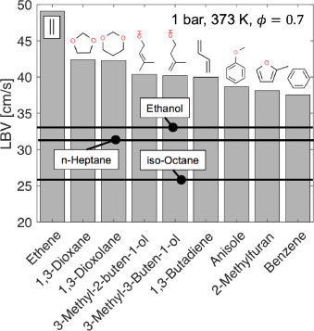
Strategic Research Area I: Carbon-based Fuel Application
Mastering Complexity of Chemical Kinetics
Carbon-based Fuel
Application
Objectives
devise and implement new numerical and experimental methods to determine the reaction network, thermodynamic, and process performance of bio-hybrid fuels that facilitate an machine learning (ML) assisted Fuel & Chemical Design Process
The exploration of universal differential equations (UDE) and natural language processing (NLP) techniques for kinetic model development and the integration of such ML approaches in established tools like FSC-tool ChemTraYzer (CTY) shall enable superior accuracy, generalizability, high computational efficiency, discovery of missing reactions, high-quality datasets, and improved parallelized training strategies.
Bio-hybrid Fuel Characterization
Carbon-based
Fuel Cells
Thermal Energy Conversion

Slide 15
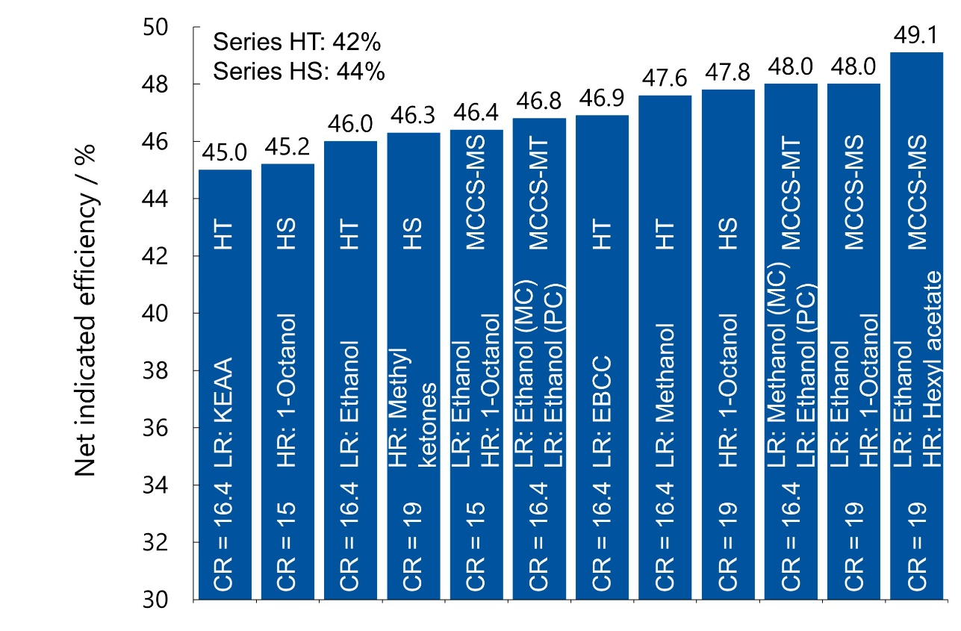
Strategic Research Area I: Carbon-based Fuel Application
Fleet Compatible Fuel and Engine Co-optimization
Carbon-based Fuel
Application
Objectives
identify bio-hybrid fuels and fuel blends that are compatible with the existing vehicle fleet
co-develop a highly adaptive molecularly controlled propulsion system design, yielding an indicated efficiency of 𝜂_{i} > 50 % for on-road passenger cars
enable a zero-impact emission strategy by combining the molecularly controlled propulsion system with a tailored and adaptive exhaust gas aftertreatment system, despite the restrictions of fleet compatibility fuel and limited hardware modifications
Bio-hybrid Fuel Characterization
Carbon-based
Fuel Cells
Thermal Energy Conversion

Slide 16
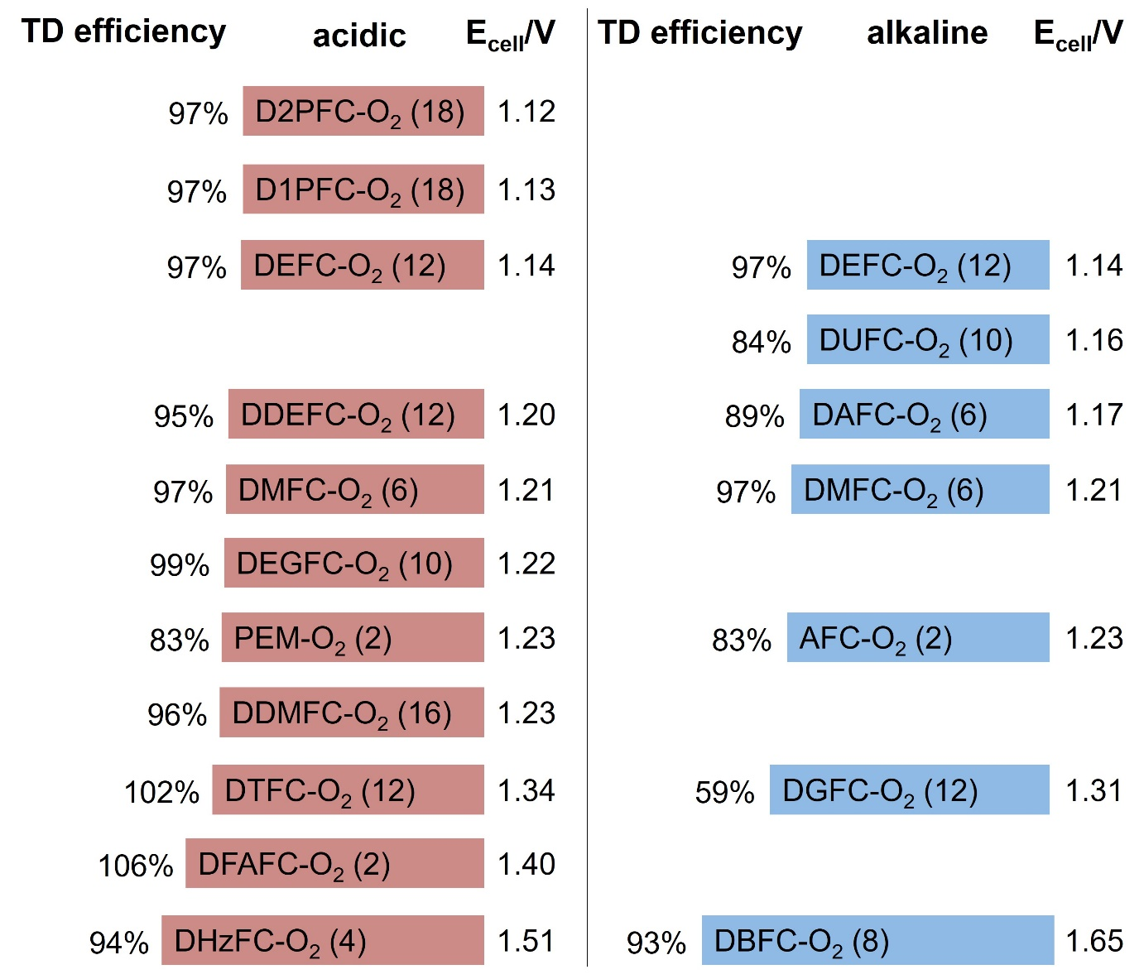
Strategic Research Area I: Carbon-based Fuel Application
Next Generation Direct Liquid Fuel Cells
Carbon-based Fuel
Application
Objectives
develop adaptive fuel cells that can work with a variety of fuels and their blends,
optimize fuel conversion by tailored fuel-catalyst interactions, screening new catalyst materials but also the fuel itself
optimize membranes for higher stability, reduced fuel cross-over without losses in the high ionic transport performance
study and mitigate degradation effects by in-depth structural analysis as well as optimized operation strategies and showing their feasibility on the system level
Bio-hybrid Fuel Characterization
Carbon-based
Fuel Cells
Thermal Energy Conversion

Slide 17
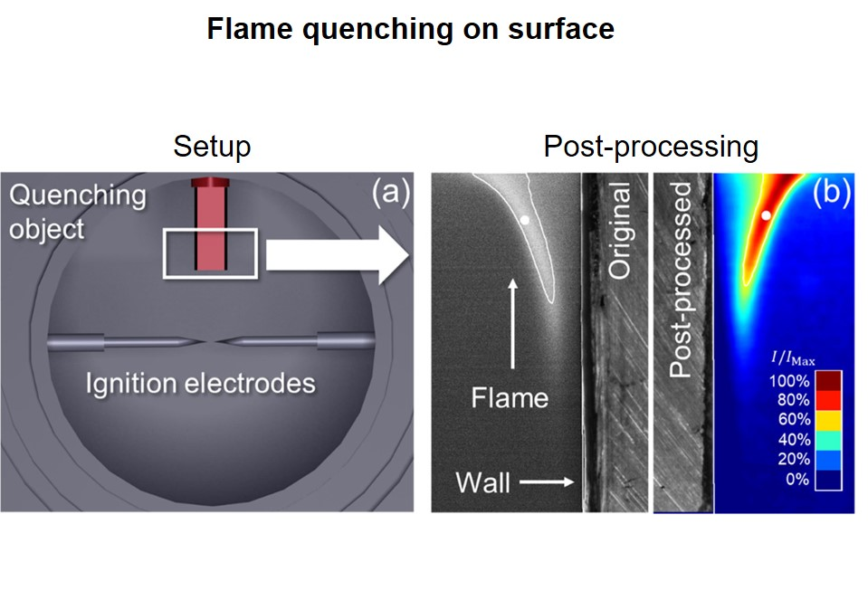
Strategic Research Area I: Carbon-based Fuel Application
Fleet Compatible Fuel and Engine Co-optimization
Carbon-based Fuel
Application
Key Challenges
near wall effects due to unfavorable surface-to-volume ratios of retrofit combustion chamber
Bio-hybrid Fuel Characterization
Carbon-based
Fuel Cells
Thermal Energy Conversion

Slide 18
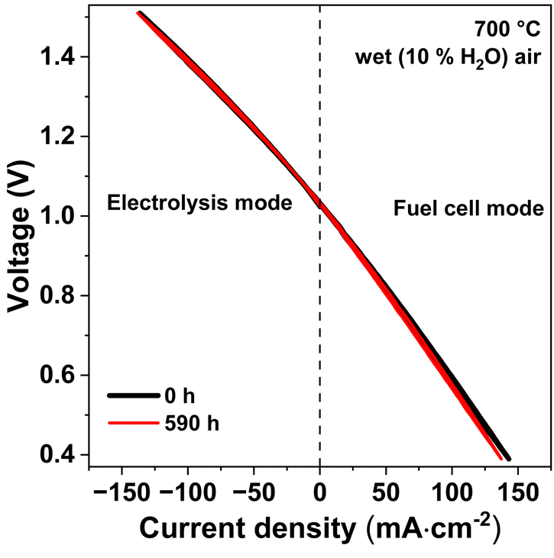
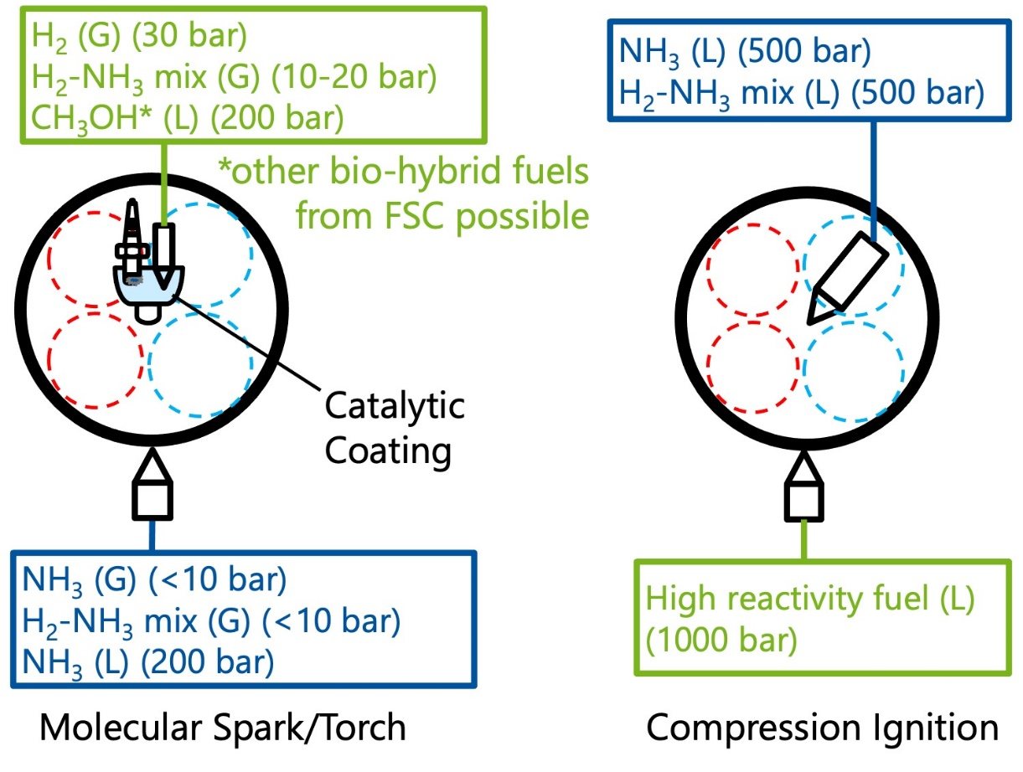
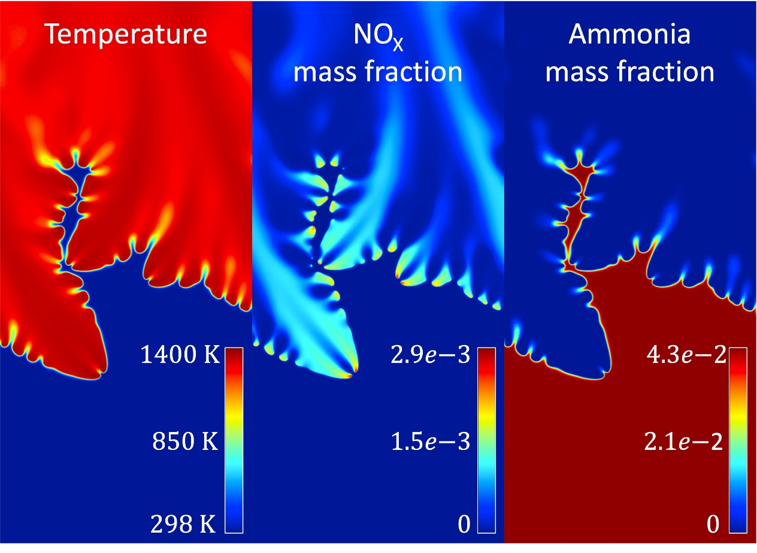
Strategic Research Area II: Ammonia Fuel Utilization
Carbon-free, Clean & Efficient Energy Conversion
Ammonia Fuel Utilization
Molecularly Controlled Combustion
  molecular torch & spark
  in-cylinder coating
  adaptive exhaust gas aftertreatment
  reactivity tailoring
Fuel & Device Compatibility
  internal reforming
  injection technology
  material interaction
Fuel Cell Technologies
  low- & high-temperature
  proton-conducting SOFC
  non nobel-metal AOR catalysts
N-emission Control
Ammonia Combustion
Ammonia Fuel Cells

Slide 19
Strategic Research Area III: Concatenated Synthetic Pathways
Catalytic Toolbox to Generate a Flexible Bio-hybrid Molecular Platform
Concatenated
Synthetic
Pathways
Separation Technologies
  distillation
  phase separation
  membrane
  crystallization
Catalyst & Reaction System
  activity
  selectivity
  stability
  reaction conditions
Molecular Design
  active sites
  mechanisms
  local environment
Interconnected Catalytic Concepts
Bio-hybrid Synthesis
Integrated Reactor Systems

Slide 20
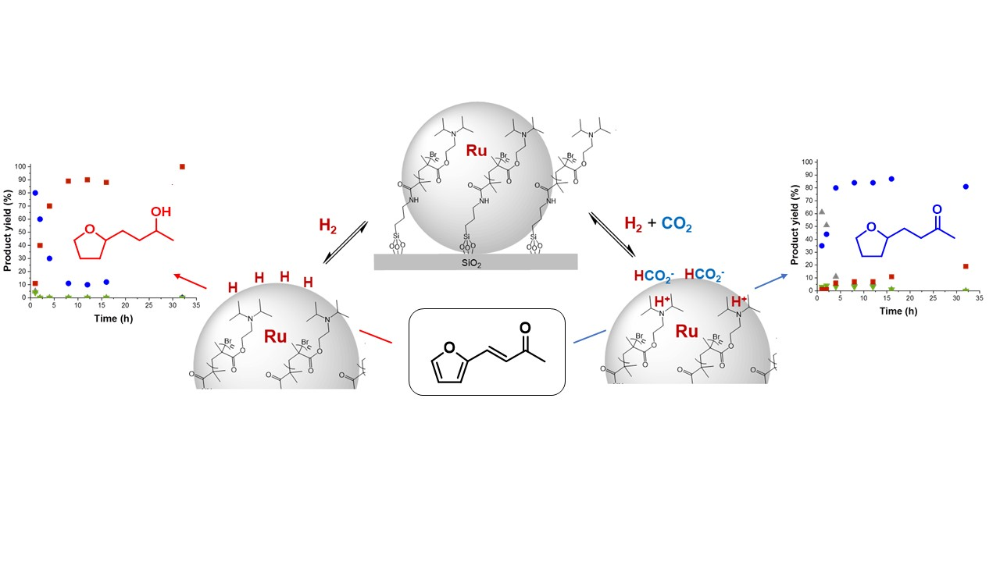
Strategic Research Area IV: Translational Catalytic Processes
Robustness and Stability despite Complex, Fluctuating Feedstocks
Translational Catalytic Processes
Adaptive Catalytic Systems
  robust & flexible
  phase separation
  membrane crystallization
Raw Material Complexity
  catalyst
  transformation
  reactor system
Dynamics of Catalytic Systems
  operando spectroscopic techniques
  online kinetic analysis
  complex phase behavior
Feedstock Complexity & Variability
Energy Input & Fluctuation
Integrated Feedstock Supply & Conversion

Slide 21
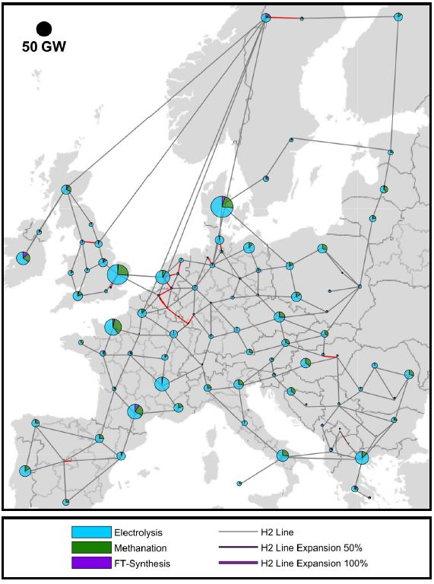
Strategic Research Area IV: Resilient & Adaptive Conversion Systems
Resilience and Adaptivity Across Scales
Resilient & Adaptive Conversion Systems
Multisectoral Global Model
  robust & flexible
  phase separation
  membrane crystallization
Stakeholder Integration
  stakeholders’ incentives
  policy design
  systemic risk measures
Holistic Sustainability
Assessment
  environmental
  social
  economical
Fuel & Chemical Design
System
Integration
Life Cycle Assessment

Slide 22
