Slide 1

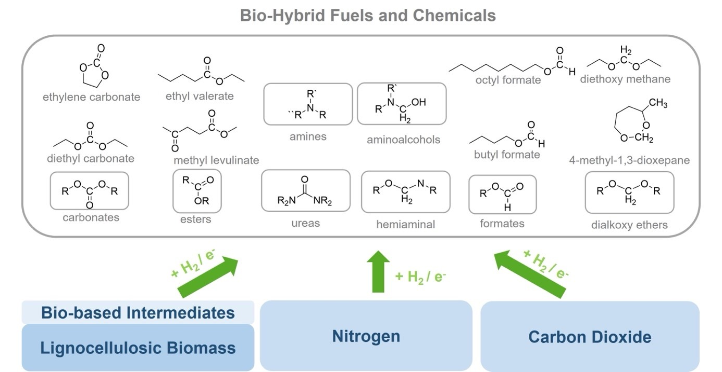
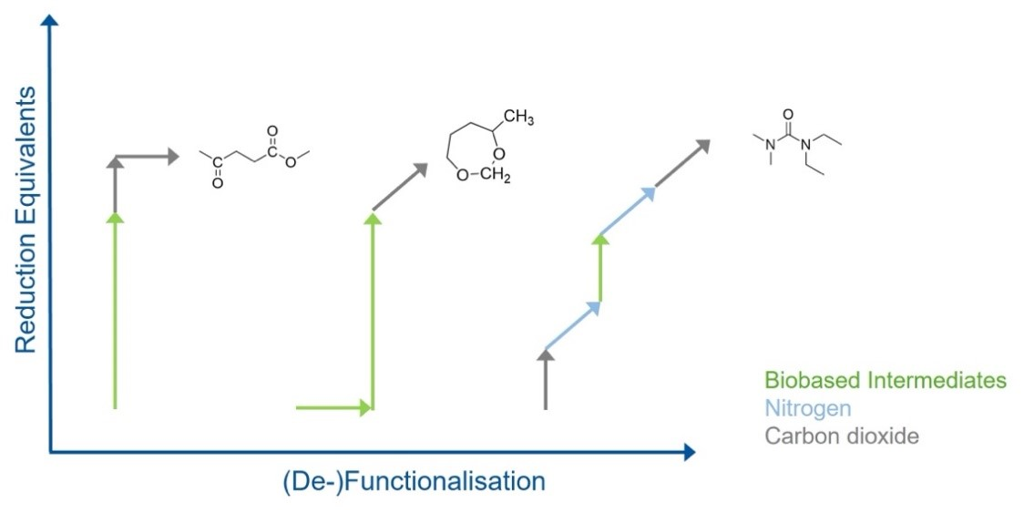
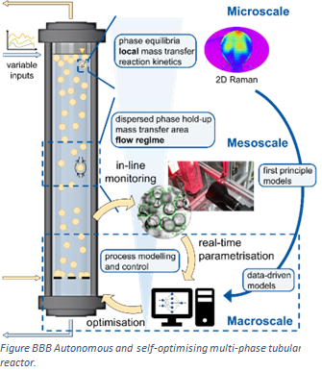
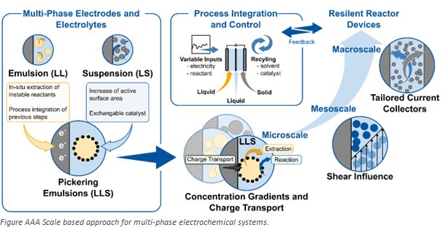
Strategic Research Area III: Concatenated Synthetic Pathways
Catalytic Toolbox to Generate a Flexible Bio-hybrid Molecular Platform
Separation Technologies
  distillation
  phase separation
  membrane
  crystallization
Catalyst & Reaction System
  activity
  selectivity
  stability
  reaction conditions
Molecular Design
  active sites
  mechanisms
  local environment

Slide 2
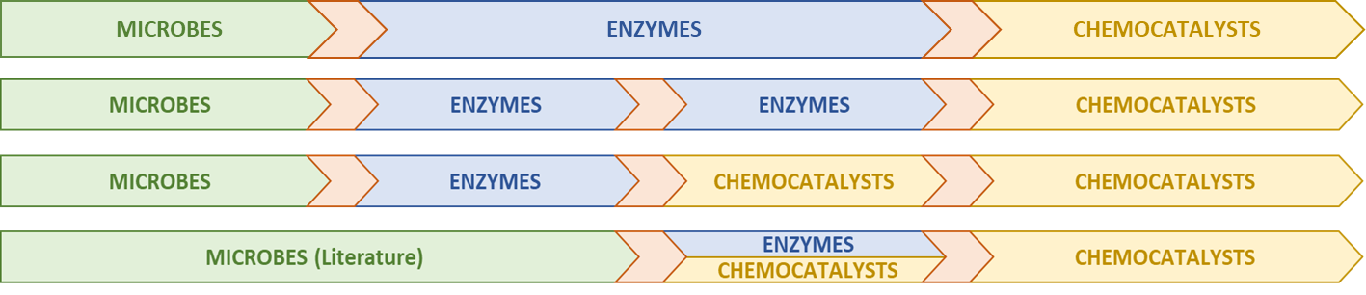
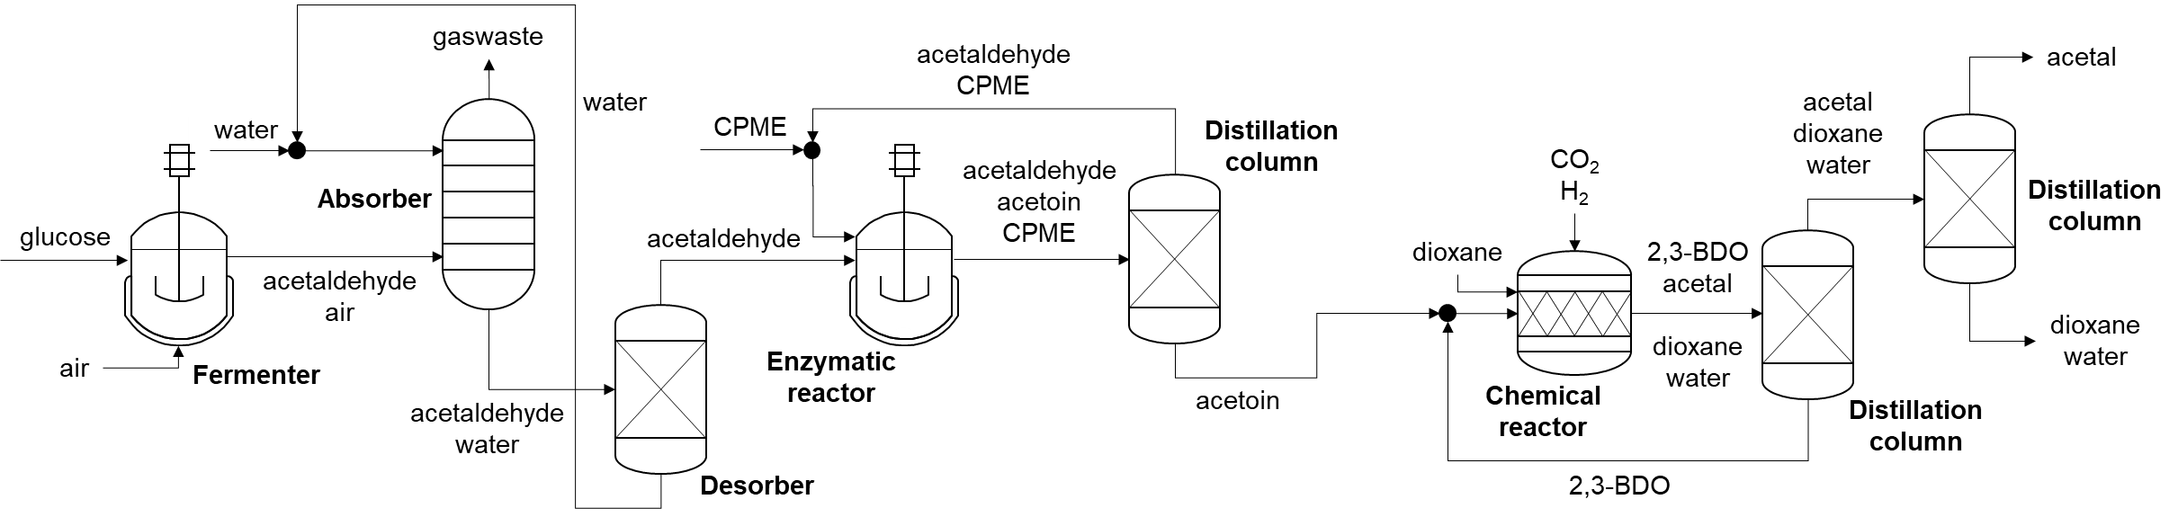
Strategic Research Area III: Concatenated Synthetic Pathways
Catalytic Toolbox to Generate a Flexible Bio-hybrid Molecular Platform
Aq.
Org.
Org.
Org.
Glucose
Aldehyde
Hydroxyketone
Diol
1,3 -Dioxolane

