Slide 2
Confidential!
We kindly ask that all content shared in this meeting be treated with the utmost confidentiality. Your cooperation is greatly appreciated.
If anyone feels a conflict due to another cooperation or obligation, we respectfully ask you to excuse yourself from this session.

Slide 3
Guiding Questions for the Discussion
1. Are the Vision & Mission Well-Articulated?
Does the mission statement of the research program clearly define its goals and purpose?
Are the objectives of the research program aligned with the overall mission and vision?
2. Is the Structure of the Research Program Sound?
Do the Strategic Research Areas (SRAs) provide a logical and coherent structure that supports our goals?
Are the different components of the program well-integrated and do they effectively contribute to the overall success?
3. Is the Research Initiative Sufficiently Motivated?
Have we provided a strong and compelling rationale for the research initiative?
Do the proposed research questions address significant gaps or needs in the current knowledge?
4. Are There Any Creative and Innovative Suggestions for Supporting Activities?
What additional strategies can we employ to enhance the visibility and impact of the research program through public engagement and outreach?
How can we improve our efforts in nurturing young talent and fostering the next generation of researchers within the program?
Are there innovative approaches to knowledge transfer and collaboration that we should consider incorporating into our activities?

Slide 4
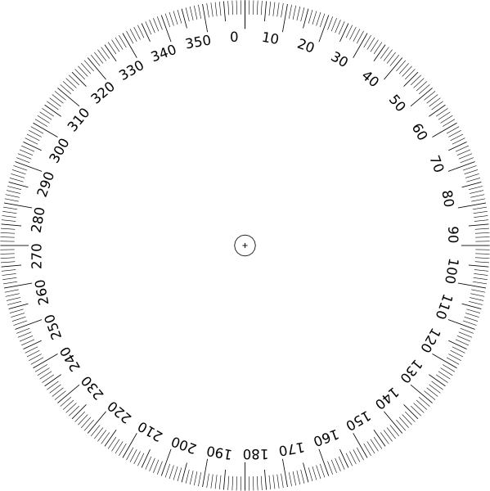
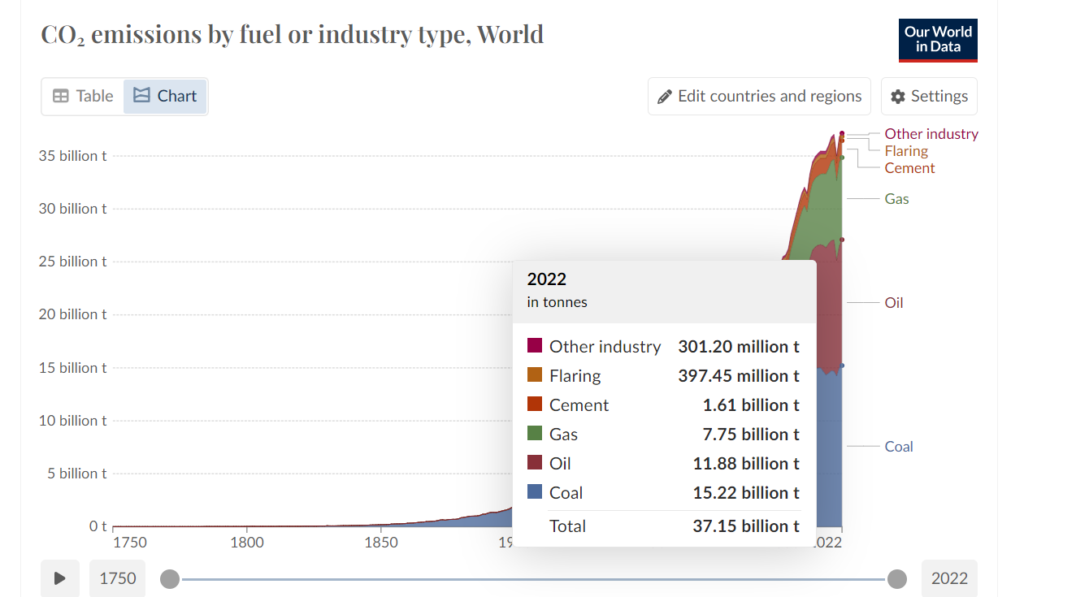
Global greenhouse gas emissions In 2022
53.8
Gt/a CO₂eq
Notes:
https://ourworldindata.org/emissions-by-sector

Slide 5
Global greenhouse gas emissions by Fuel Type In 2022
99.6
Mio. Barrels
/Day
32.0 %
Oil
11.9
37.15
Gt/a CO₂eq
Gt/a CO₂eq
41.0 %
Coal
8.4
Gt/a CO₂eq
20.8 %
Gas
6.2 %
Other
Hannah Ritchie, Pablo Rosado and Max Roser (2020) - “CO₂ emissions by fuel” Published online at OurWorldInData.org. Retrieved from: 'https://ourworldindata.org/emissions-by-fuel'

Slide 6
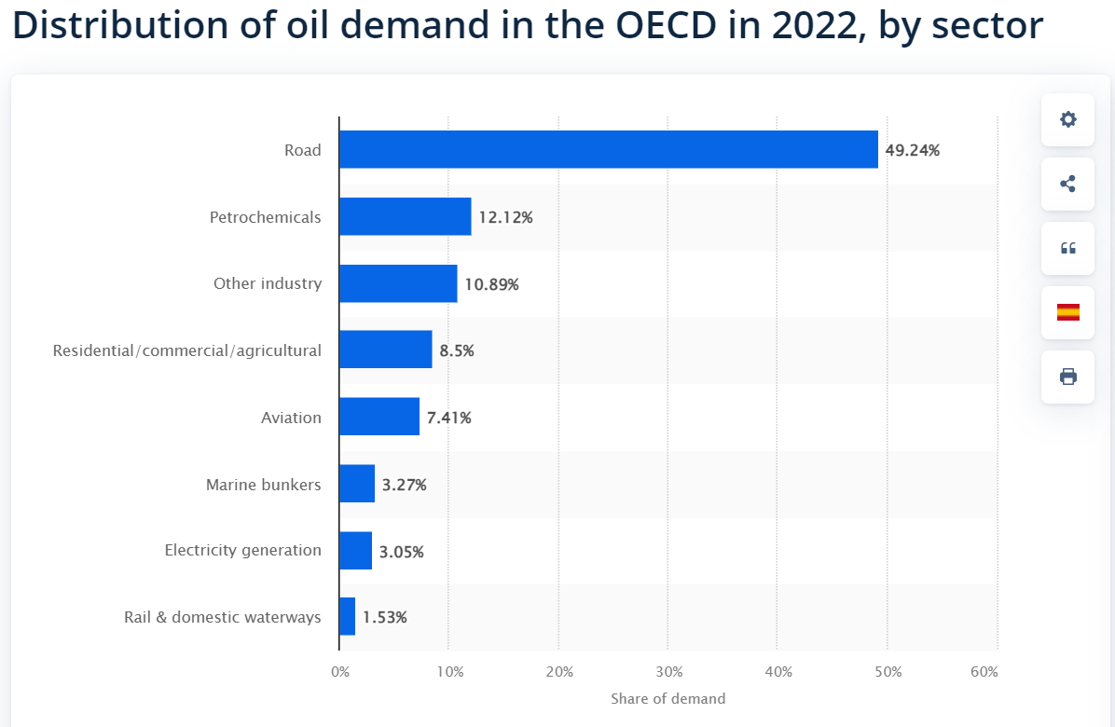
Distribution of oil demand in the OECD in 2022, by sector
12.1 %
Chemicals
99.6
Mio. Barrels
/Day
32.0 %
Oil
Other Industrie
11.9
6.2 %
37.15
Gt/a CO₂eq
Gt/a CO₂eq
Fuels
Residential, Commercial, Agriculture
8.5 %
61.5 %
41.0 %
Coal
8.4
Gt/a CO₂eq
3 %
Electricity Generation
20.8 %
Gas
6.2 %
Other
OPEC. (December 13, 2023). Distribution of oil demand in the OECD in 2022, by sector [Graph]. In Statista. Retrieved June 12, 2024, from https://www.statista.com/statistics/307194/top-oil-consuming-sectors-worldwide/

Slide 7
Distribution of oil demand in the OECD in 2022, by sector
12.1 %
Chemicals
61.3
Mio. Barrels
/Day
32.0 %
Oil
Other Industrie
Fuels
6.2 %
11.9
37.15
Gt/a CO₂eq
Fleet Forecast
Gt/a CO₂eq
Road
61.5 %
Residential, Commercial, Agriculture
8.5 %
41.0 %
Coal
49.2 %
1.5 %
3 %
Rail & Domestic Waterways
8.4
Gt/a CO₂eq
Electricity Generation
20.8 %
Gas
Marine
6.2 %
Other
2020
2030
2040
2050
2020
2030
2040
2050
3.3 %
Aviation
OPEC. (December 13, 2023). Distribution of oil demand in the OECD in 2022, by sector [Graph]. In Statista. Retrieved June 12, 2024, from https://www.statista.com/statistics/307194/top-oil-consuming-sectors-worldwide/
7.4 %

Slide 8
Conventional Powertrains Still on the Road in 2050
Fleet Forecast for EU Transport
12.1 %
Chemicals
$$H$$
$$H$$
$$H$$
61.3
Mio. Barrels
/Day
32.0 %
$$H$$
$$H$$
$$N$$
$$C$$
Oil
$$H$$
$$O$$
$$H$$
$$H$$
$$H$$
Fuels
11.9
Gt/a CO₂eq
Fleet Forecast
Road
49.2 %
2020
2030
2040
2050
2020
2030
2040
2050
1) The extended tank-to-wheel considers the CO2 emissions created when converting the energy carrier to kinetic energy and a subtract of carbon sinks that are realized during the production of the energy carrier Source: FEV

Slide 9
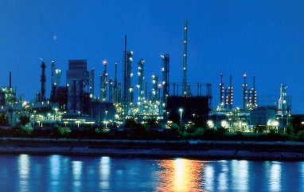
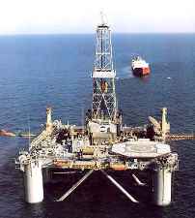
Fuel & Chemical Production
$$N$$
Health
H₂
Products (>100 000)
CO₂
Function
Care
$$N$$
Nutrition
Intermediates (<100)
H₂
CO₂
Base Chemicals (<10)
20%
$$N$$
H₂
80%
Fuels
CO₂
Crude Oil -(CH₂)-

Slide 10
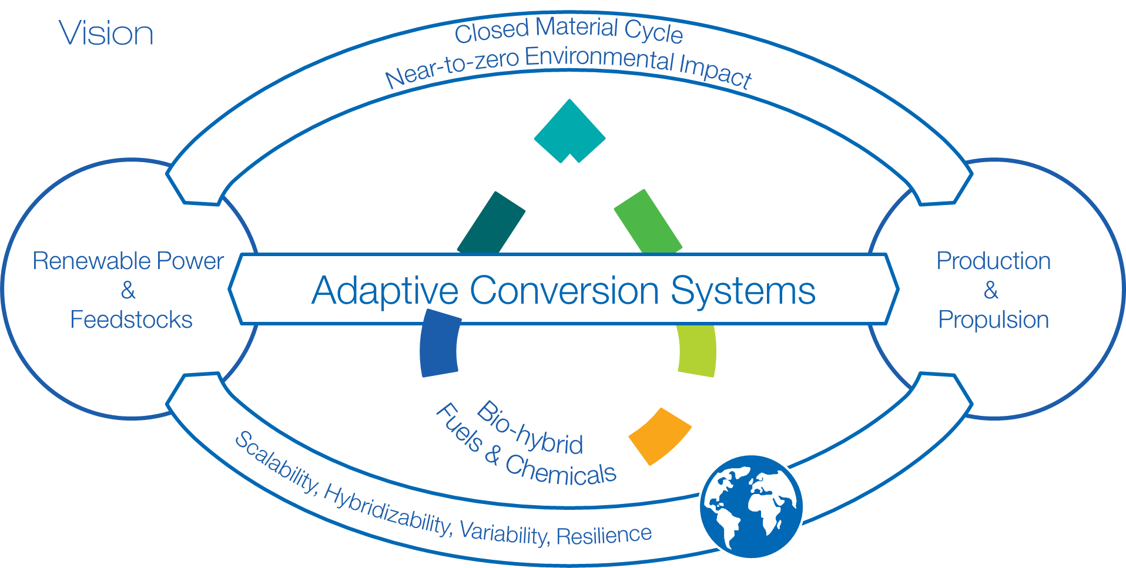
The Integrated Fuel & Chemical Science Center
IAB Meeting | Aachen | 13.06.2024 | confidential

Slide 11
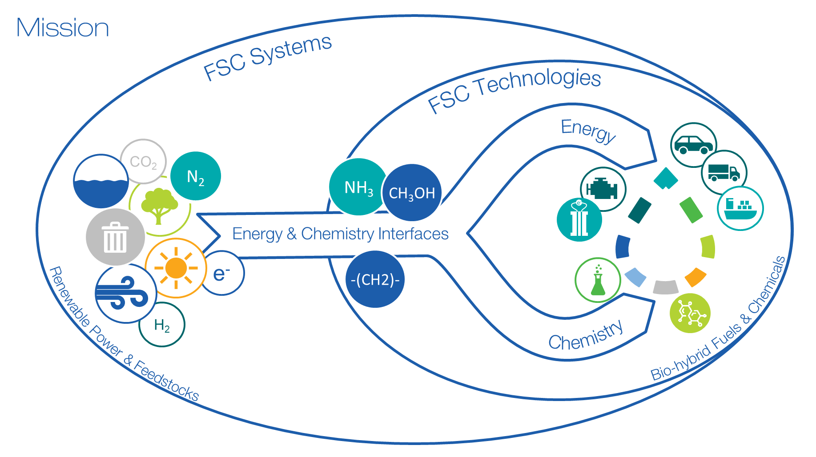

Slide 12
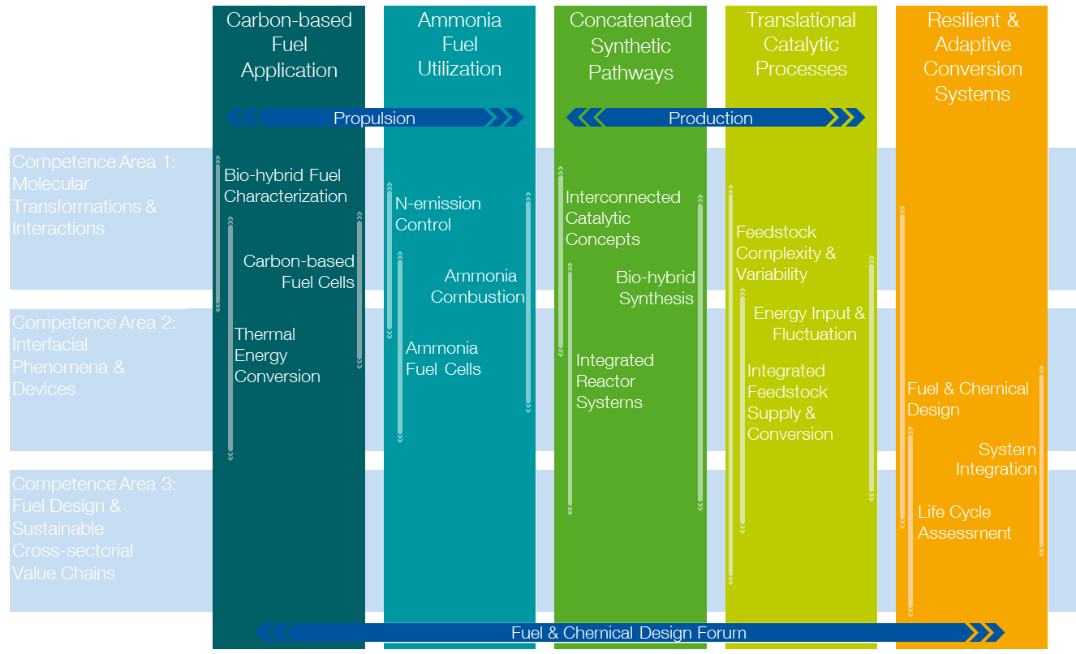
Structure of the Research Program:
Strategic Research Areas Extend Across all Competence Areas

Slide 13
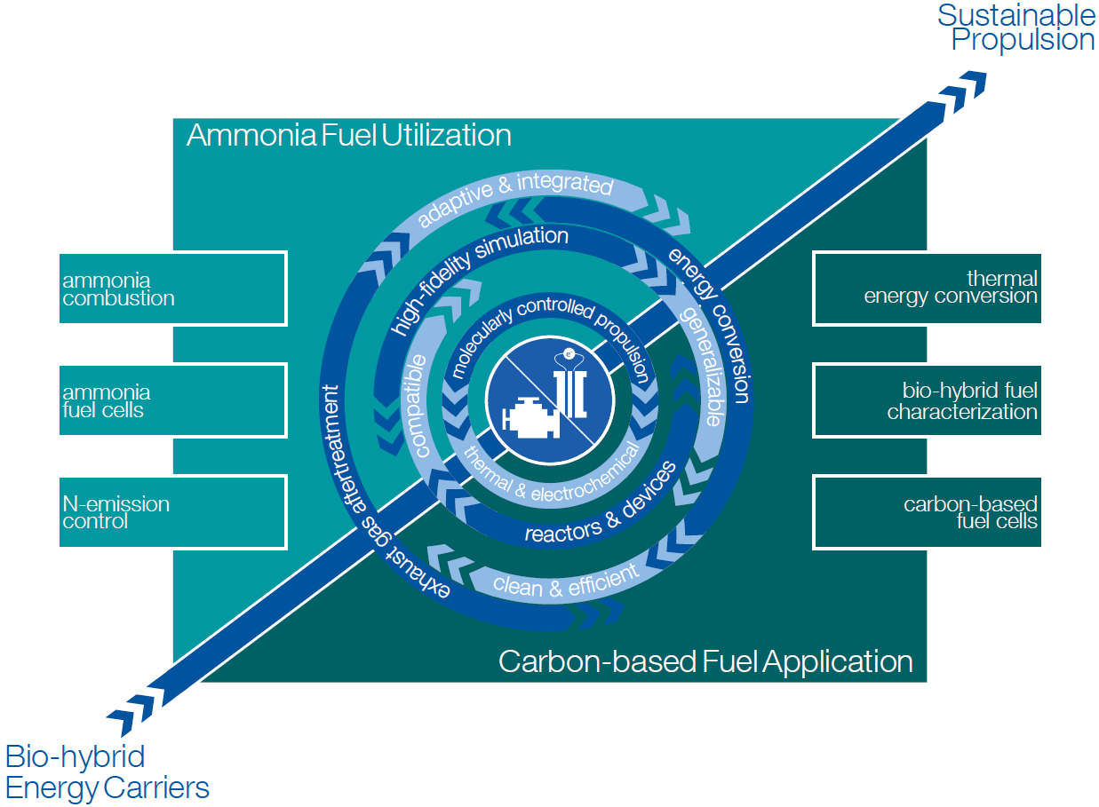
Scientific Objectives - Propulsion
Mitigate carbon emissions from existing vehicle fleet by developing bio-hybrid fuel based molecularly-controlled engine concepts that can be retrofitted to existing combustion systems enabled through advanced technologies for combustion and aftertreatment systems with energy conversion efficiencies beyond 50 % and near-zero pollutant emissions.
Develop carbon- and ammonia-based fuel cell concepts and ammonia-fueled combustion engines for new passenger vehicles, heady-duty, and marine applications enabled by fundamental understanding of the involved thermochemical and electrochemical processes

Slide 14
Strategic Research Area I: Carbon-based Fuel Application
Molecularly Controlled Propulsion Systems
Molecularly Controlled Combustion
molecular torch & spark
in-cylinder coating
adaptive exhaust gas aftertreatment

Slide 15
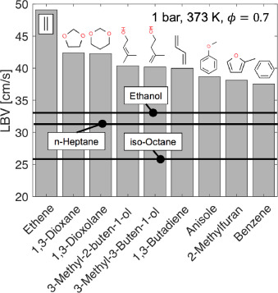
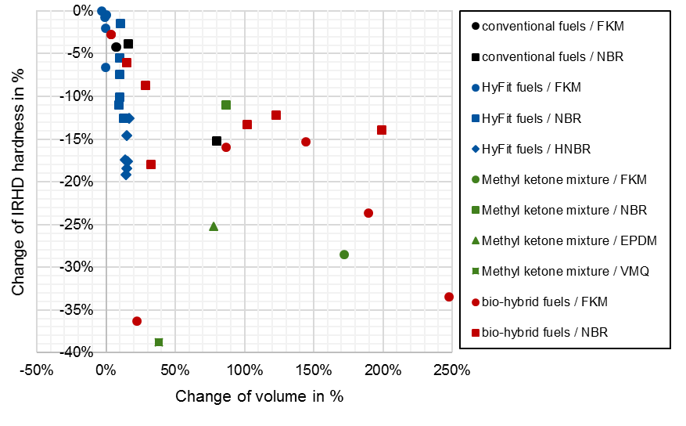
Strategic Research Area I: Carbon-based Fuel Application
Molecularly Controlled Propulsion Systems
Molecularly Controlled Combustion
molecular torch & spark
in-cylinder coating
adaptive exhaust gas aftertreatment
Fuel & Device Compatibility
combustion characteristics
tribology & elastohydrodynamics
long-term behavior
via accelerated testing & simulation

Slide 16
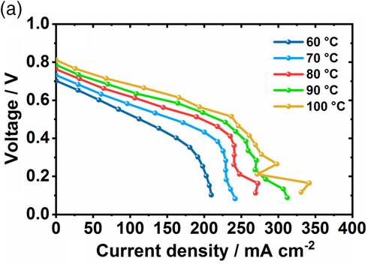
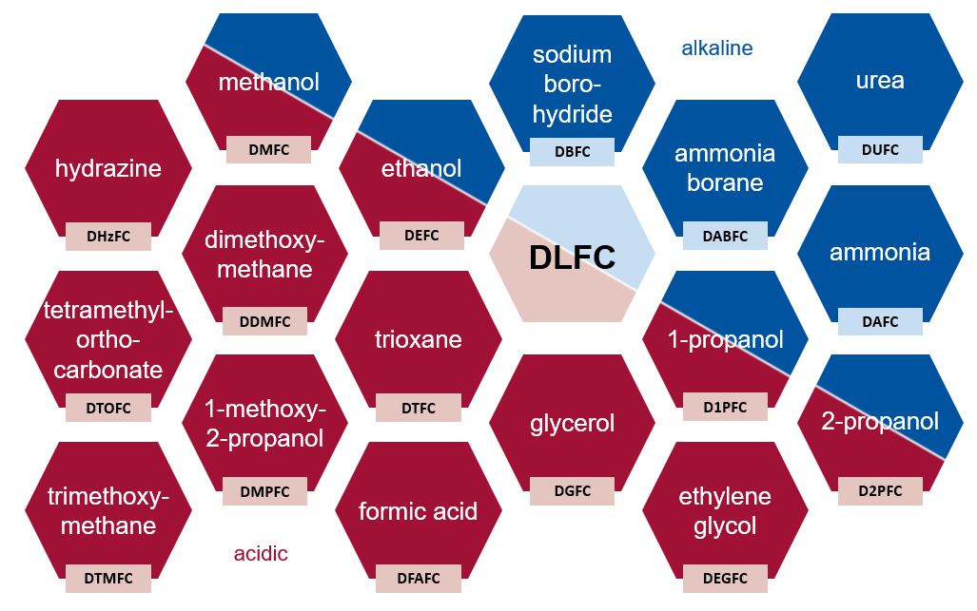
Strategic Research Area I: Carbon-based Fuel Application
Molecularly Controlled Propulsion Systems
Molecularly Controlled Combustion
molecular torch & spark
in-cylinder coating
adaptive exhaust gas aftertreatment
Fuel & Device Compatibility
combustion characteristics
tribology & elastohydrodynamics
long-term behavior
via accelerated testing & simulation
Fuel Cell Technologies
low- & high-temperature
flex-fuel
dynamic operation
P. Hauenstein, D. Seeberger, P. Wasserscheid, S. Thiele, Electrochem. Commun. 2020, 118, 106786

Slide 17
Strategic Research Area II: Ammonia Fuel Utilization
Motivation
Carbon-neutral energy systems → Hydrogen-based energy carriers
Direct thermochemical or electrochemical conversion of ammonia → Challenges
Low energy density
expensive transport & storage
If reformed from NH₃ → efficiency losses, purification required for conventional fuel cells
Liquefaction at moderate pressure
long-distance transport & long-term storage
Well-understood & possible carbon-neutral production
H₂
NH₃
Ammonia combustion engines
Ammonia fuel cells
Difficult to ignite → unstable combustion
Slow flame speed
unstable combustion, low efficiency
Fuel-inherent nitrogen → emissions of NO_{x}, N₂O, NH₃
High-temperature fuel cells: NO_{x} formation
Low-temperature fuel cells: catalyst poisoning & membrane degradation
e⁻

Slide 18
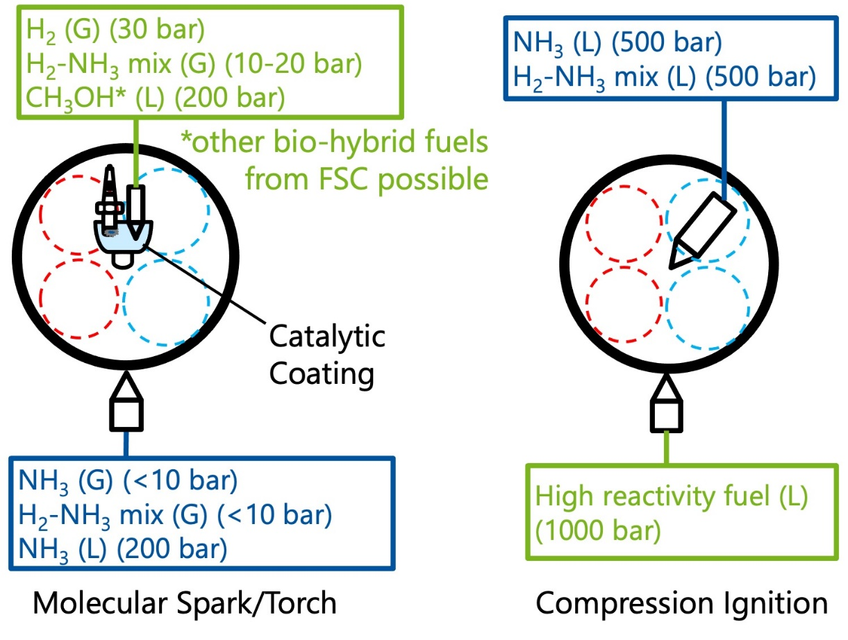
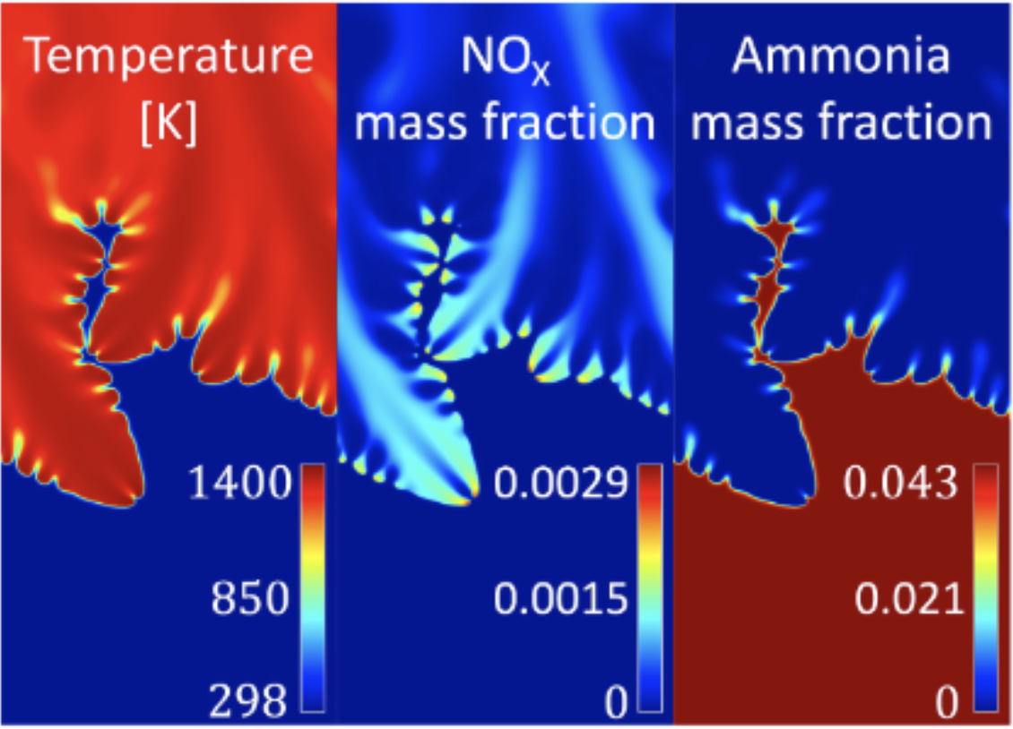
Strategic Research Area II: Ammonia Fuel Utilization
Ammonia Combustion
Intrinsic instability flame speed boosting
Ammonia engines
Stable combustion
High thermal efficiency
Near-zero emissions
Pre-chamber ignition using heating or catalytic surfaces
In-cylinder combustion staging by tailored stratification
Ignition accelerators:
Tailored NH₃-reforming
Bio-hybrid fuels
Intrinsic flame instabilities in laminar ammonia-hydrogen-air flame with 40 vol-% hydrogen

Slide 19
Strategic Research Area II: Ammonia Fuel Utilization
Ammonia Fuel Cells
NO_{x} reduction:
Adaptive fuel compositions
Solid proton-conducting fuel cells
Low- & high-temperature ammonia fuel cells
Exceptional performance
High economic viability
Low cross-over, poisoning & NOx formation
NH₃ cross-over reduction & life-time increase by fluorine-free AEMs
Overpotential & poisoning minimization by single- / biatom metal catalysts & hybridization
e⁻
e⁻
O²⁻
/
H⁺
H⁺
High-temperature ammonia fuel cells
Low-temperature direct ammonia fuel cells

Slide 20
Strategic Research Area II: Ammonia Fuel Utilization
Ammonia Fuel Cells
NO_{x} reduction:
Adaptive fuel compositions
Solid proton-conducting fuel cells
Low- & high-temperature ammonia fuel cells
Exceptional performance
High economic viability
Low cross-over, poisoning & NOx formation
NH₃ cross-over reduction & life-time increase by fluorine-free AEMs
Overpotential & poisoning minimization by single- / biatom metal catalysts & hybridization
e⁻
e⁻
O²⁻
/
H⁺
H⁺
High-temperature ammonia fuel cells
Low-temperature direct ammonia fuel cells

Slide 21
Strategic Research Area II: Ammonia Fuel Utilization
N-emission Control
Microwave enabled aftertreatment system
Coupled NO_{x}+N₂O aftertreatment
Excellent low-temperature performance
Reuse of exhaust NH₃ & released H₂
New catalysts for coupled N₂O+NO_{x} aftertreatment under Microwave- stimulation
New spectroscopic setups for exhaust component monitoring & reactive MD for operando modeling
Alloy catalysts for reforming NH₃ post oxidation. Metal halides & zeolites for slipped NH₃ storage
In-house setup for Microwave-stimulated catalysis

Slide 22
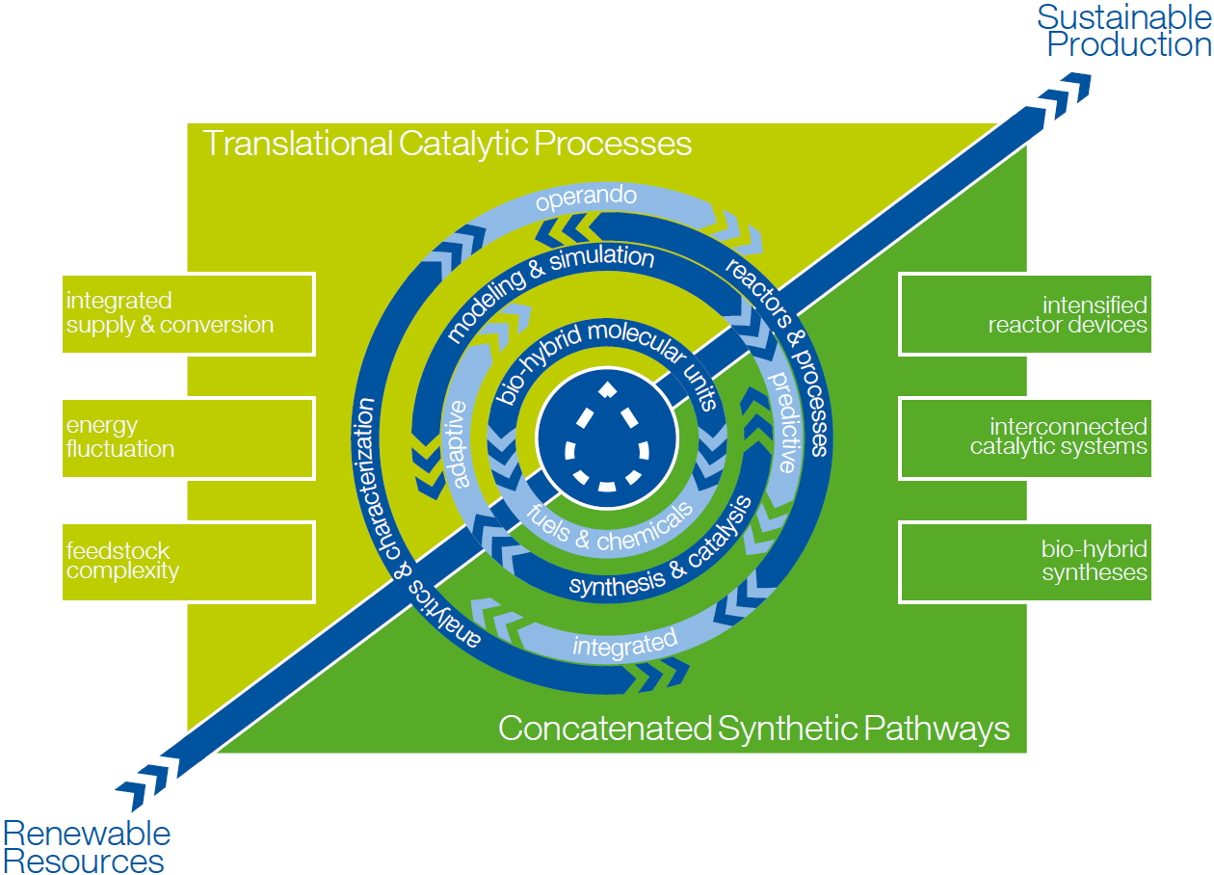
Scientific Objectives - Production
Exploration of chemo-, bio- and electro-catalytic pathways for the selective formation of C-H, C-C, C-O, and C-N bonds from renewable resources with the aim to integrate the individual transformations into optimized synthetic pathways for fuels and chemicals (concatenation) and their validation in view of feedstock variation and energy fluctuation in post-fossil value chains (translation).
Advancing the toolbox in experiment and theory for the investigation of complex catalytic reactions and processes to derive design principles from the molecular to the process level as input for and in response to the interdisciplinary analysis in the Fuel & Chemical Design Forum.

Slide 23
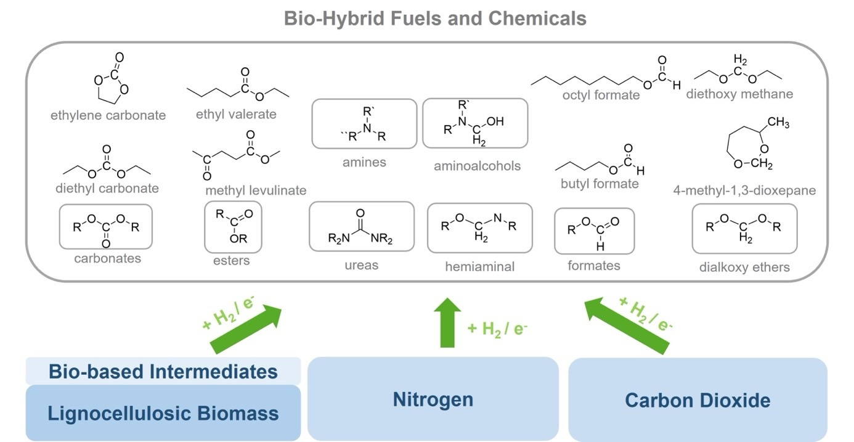
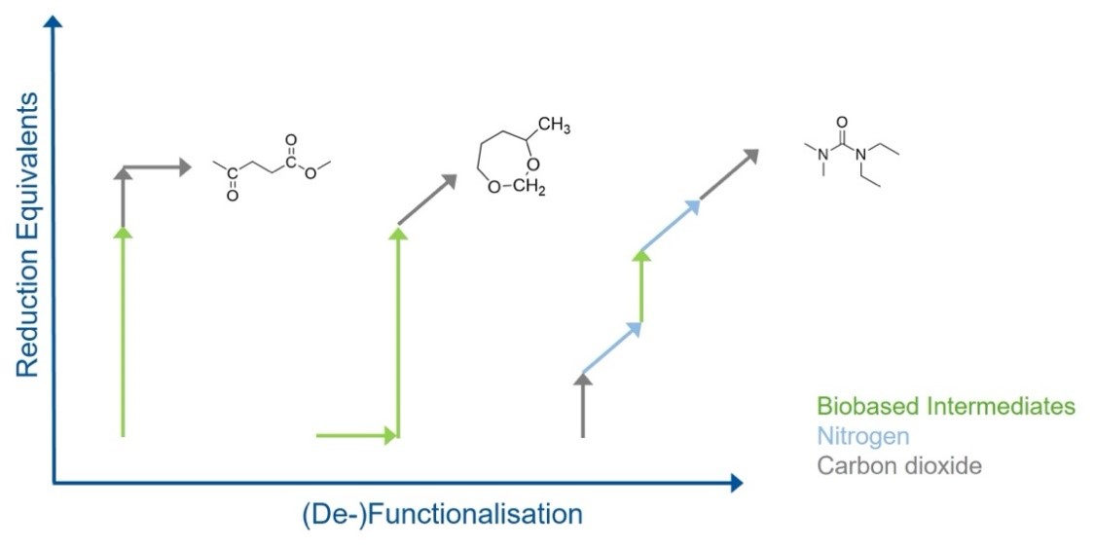
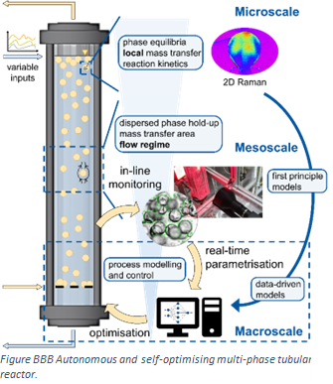
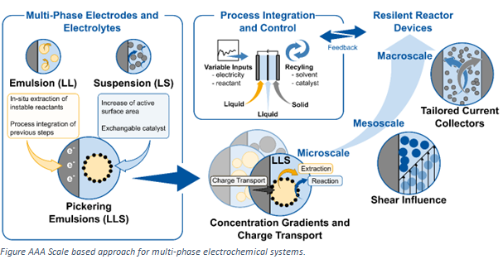
Strategic Research Area III: Concatenated Synthetic Pathways
Catalytic Toolbox to Generate a Flexible Bio-hybrid Molecular Platform
Separation Technologies
distillation phase separation membrane crystallization
Catalyst & Reaction System
activity selectivity stability reaction conditions
Molecular Design
active sites mechanisms local environment

Slide 24
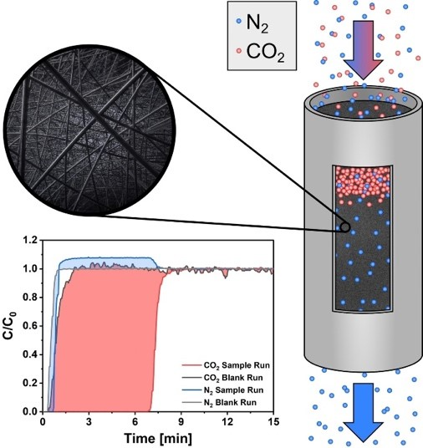
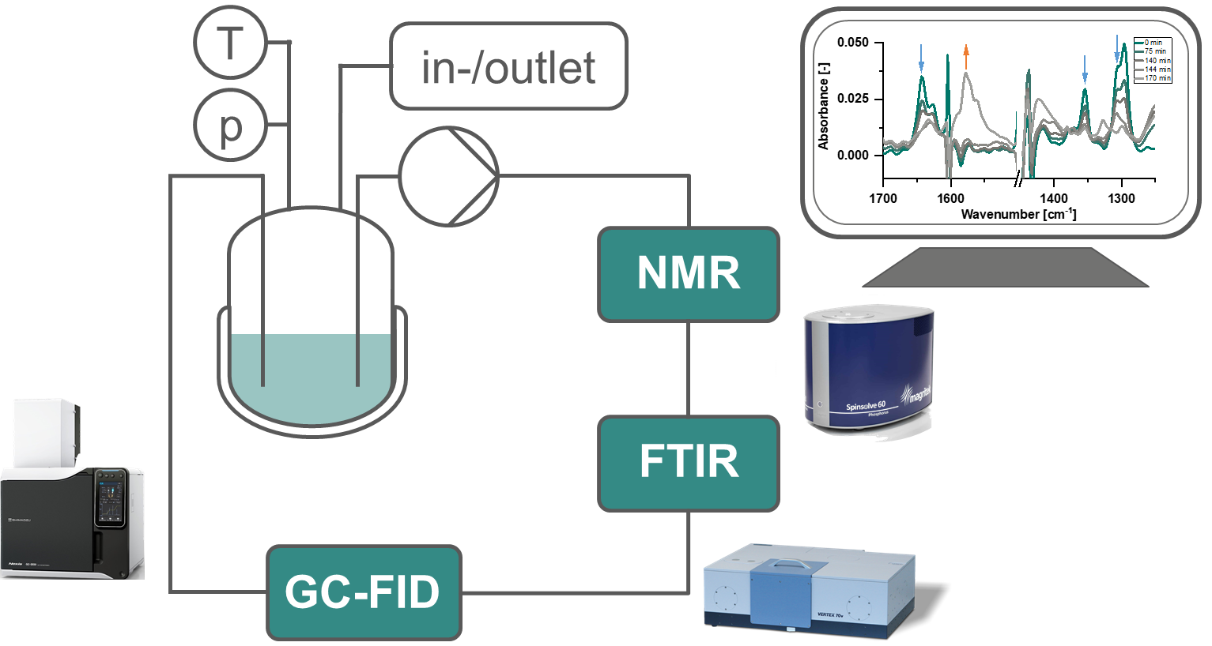
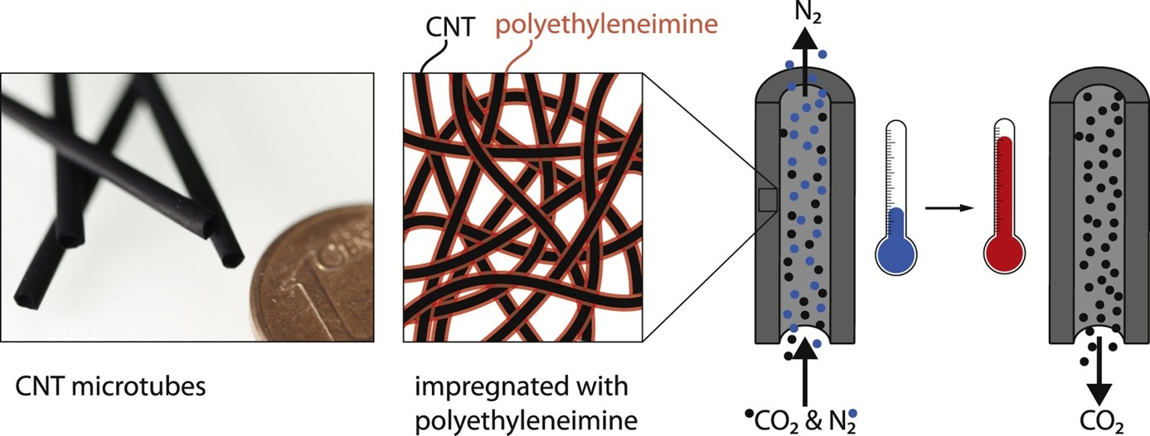
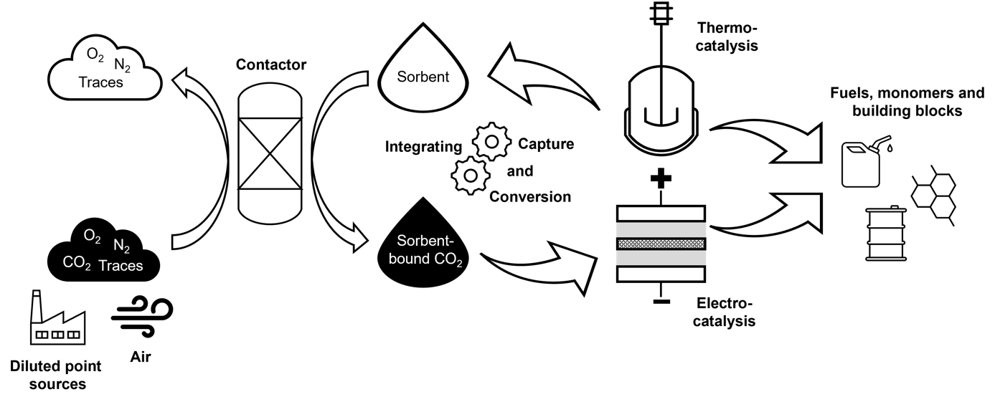
Strategic Research Area IV: Translational Catalytic Processes
Robustness and Stability despite Complex, Fluctuating Feedstocks
Robust & Flexible
quality variation substrate mixtures trace impurities
Adaptive Catalytic Systems
external stimulus switchable systems multiscale control
Dynamics of Catalytic Systems
operando spectroscopic techniques online kinetic analysis complex phase behavior
Borescope

Slide 25
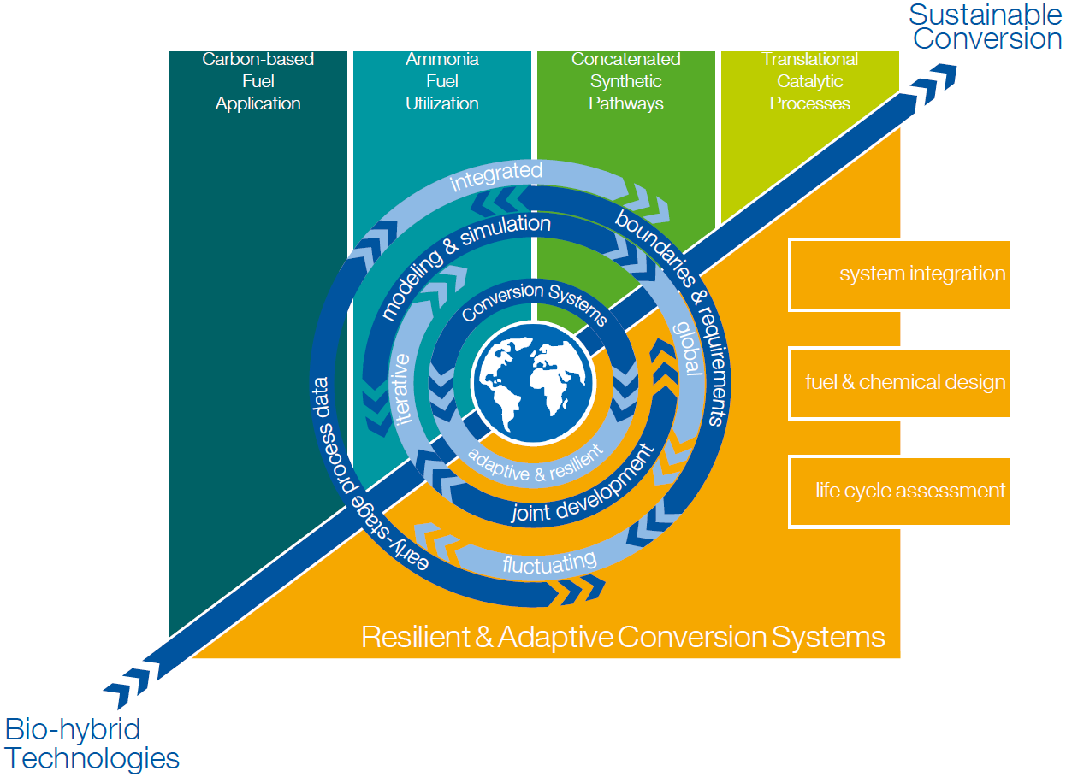
Scientific Objectives - System
System integration of the developed fuels, processes and pathways is enabled by interdisciplinary assessment and optimization of resilient and adaptive intersectoral conversion systems based on systemic risks, stakeholder perspectives, policies and sustainability criteria.
Life-cycle assessment will be extended to better analyze the sustainable impacts and to optimize fuels and chemicals based on a cross-sectorial approach integrating prediction-based (eco-)toxicity assessment, regarding planetary boundaries, and integrating socio-political implications and circular economy aspects.
The fuel and chemical design optimizes the overall conversion performance, accounting for fleet-compatible and novel propulsion concepts and co-production of chemicals and fuels; this is done by developing and employing cutting-edge methods from propulsion equipment design, production process development, and machine learning.

Slide 26
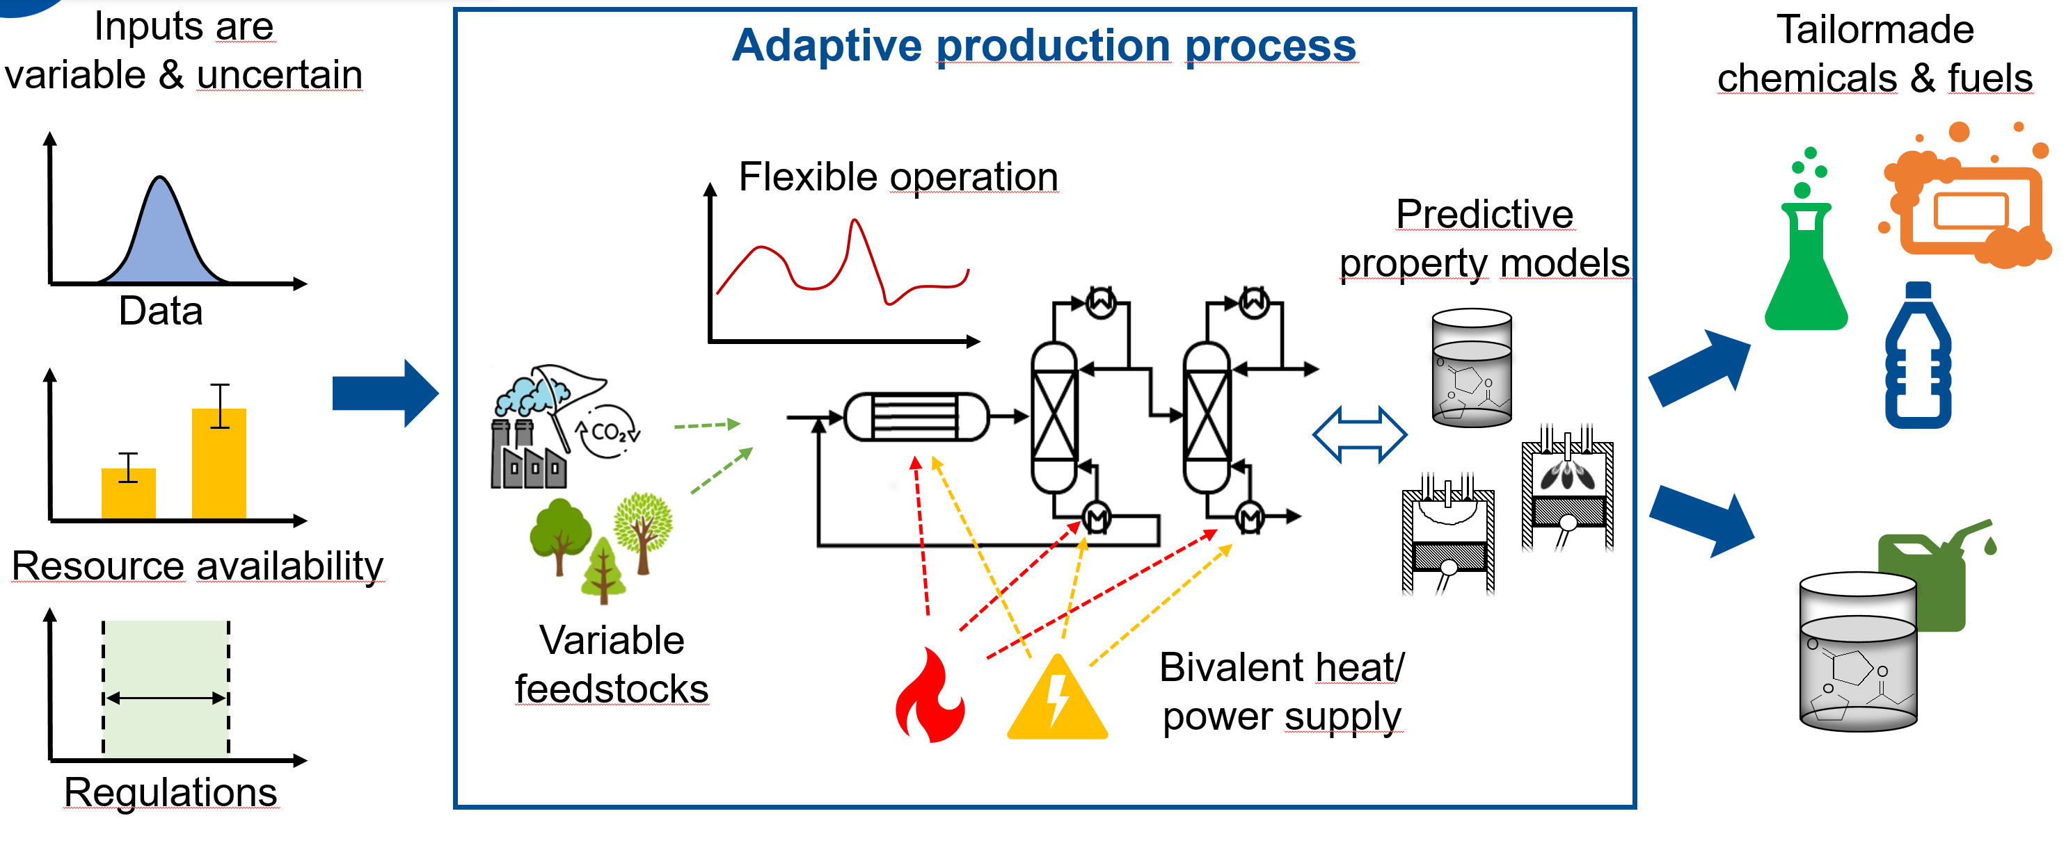
Strategic Research Area V: Resilient & Adaptive Conversion Systems
Resilience and Adaptivity Across Scales
Product – Process Design
production – propulsion
fuel/chemical – process
optimization & prediction

Slide 27
Strategic Research Area V: Resilient & Adaptive Conversion Systems
Resilience and Adaptivity Across Scales
Product – Process Design
production – propulsion
fuel/chemical – process
optimization & prediction
Conversion System
behavior, unintended effects, interrelations, communication
analysis, prediction, prescription
Fuel & Chemical Conversion System
multisectoral global model
Fuel & Chemical Design
System Expansion
Competitive
chemicals & fuels, energy
process paths
demand sectors

Slide 28
Strategic Research Area V: Resilient & Adaptive Conversion Systems
Resilience and Adaptivity Across Scales
Product – Process Design
production – propulsion
fuel/chemical – process
optimization & prediction
Conversion System
behavior, unintended effects, interrelations, communication
analysis, prediction, prescription
§
Stakeholders
Perspectives → Incentives
Policies
Assessment → Design
Systemic Risk
Stressors → Measures
Fuel & Chemical Conversion System
multisectoral global model
Fuel & Chemical Design
System Expansion
Competitive
chemicals & fuels, energy
process paths
demand sectors

Slide 29
Strategic Research Area V: Resilient & Adaptive Conversion Systems
Resilience and Adaptivity Across Scales
Product – Process Design
production – propulsion
fuel/chemical – process
optimization & prediction
Conversion System
behavior, unintended effects, interrelations, communication
analysis, prediction, prescription
Sustainability Assessment
prediction-based toxicity
planetary boundaries vs.
basic (societal) needs
§
Stakeholders
Perspectives → Incentives
Policies
Assessment → Design
Systemic Risk
Stressors → Measures
Fuel & Chemical Conversion System
multisectoral global model
Fuel & Chemical Design
System Expansion
Competitive
chemicals & fuels, energy
process paths
demand sectors
Toxicity
Endpoints, Prediction & Uncertainties
Policies
Assessment → Design
Circular Carbon Economy
LCA & MFA Integration & Indicators

Slide 30
Strategic Research Area V: Resilient & Adaptive Conversion Systems
Resilience and Adaptivity Across Scales
Product – Process Design
Conversion System
Sustainability Assessment
Design of Resilient & Adaptive Sustainable Conversion Systems
adaptive, flexible, redundant, multi-functional, loosely coupeld, within planetary boundaries, circular,…
§
Stakeholders
Perspectives → Incentives
Policies
Assessment → Design
Systemic Risk
Stressors → Measures
Fuel & Chemical Conversion System
multisectoral global model
Fuel & Chemical Design
System Expansion
Competitive
chemicals & fuels, energy
process paths
demand sectors
Toxicity
Endpoints, Prediction & Uncertainties
Policies
Assessment → Design
Circular Carbon Economy
LCA & MFA Integration & Indicators

Slide 31
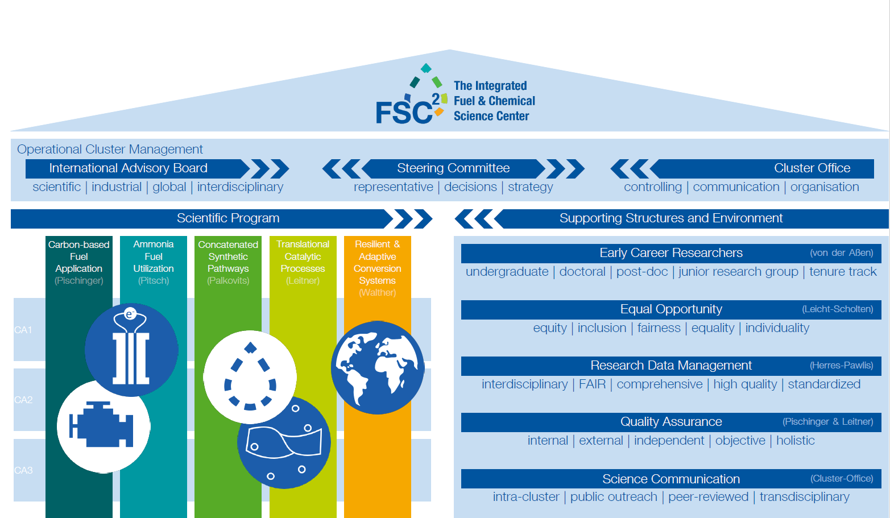

Slide 32
Guiding Questions for the Discussion
1. Are the Vision & Mission Well-Articulated?
Does the mission statement of the research program clearly define its goals and purpose?
Are the objectives of the research program aligned with the overall mission and vision?
2. Is the Structure of the Research Program Sound?
Do the Strategic Research Areas (SRAs) provide a logical and coherent structure that supports our goals?
Are the different components of the program well-integrated and do they effectively contribute to the overall success?
3. Is the Research Initiative Sufficiently Motivated?
Have we provided a strong and compelling rationale for the research initiative?
Do the proposed research questions address significant gaps or needs in the current knowledge?
4. Are There Any Creative and Innovative Suggestions for Supporting Activities?
What additional strategies can we employ to enhance the visibility and impact of the research program through public engagement and outreach?
How can we improve our efforts in nurturing young talent and fostering the next generation of researchers within the program?
Are there innovative approaches to knowledge transfer and collaboration that we should consider incorporating into our activities?

