Slide 2
Confidential!
We kindly ask that all content shared in this meeting be treated with the utmost confidentiality. Your cooperation is greatly appreciated.
If anyone feels a conflict due to another cooperation or obligation, we respectfully ask you to excuse yourself from this session.

Slide 3
Guiding Questions for the Discussion
1. Are the Vision & Mission Well-Articulated?
Does the mission statement of the research program clearly define its goals and purpose?
Are the objectives of the research program aligned with the overall mission and vision?
2. Is the Structure of the Research Program Sound?
Do the Strategic Research Areas (SRAs) provide a logical and coherent structure that supports our goals?
Are the different components of the program well-integrated and do they effectively contribute to the overall success?
3. Is the Research Initiative Sufficiently Motivated?
Have we provided a strong and compelling rationale for the research initiative?
Do the proposed research questions address significant gaps or needs in the current knowledge?
4. Are There Any Creative and Innovative Suggestions for Supporting Activities?
What additional strategies can we employ to enhance the visibility and impact of the research program through public engagement and outreach?
How can we improve our efforts in nurturing young talent and fostering the next generation of researchers within the program?
Are there innovative approaches to knowledge transfer and collaboration that we should consider incorporating into our activities?

Slide 4
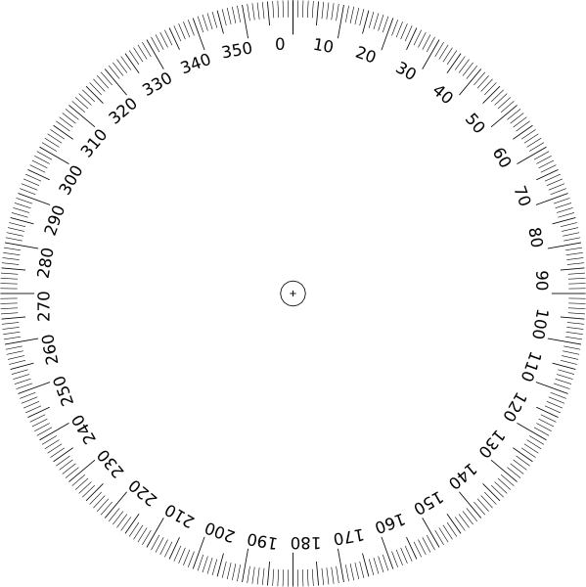
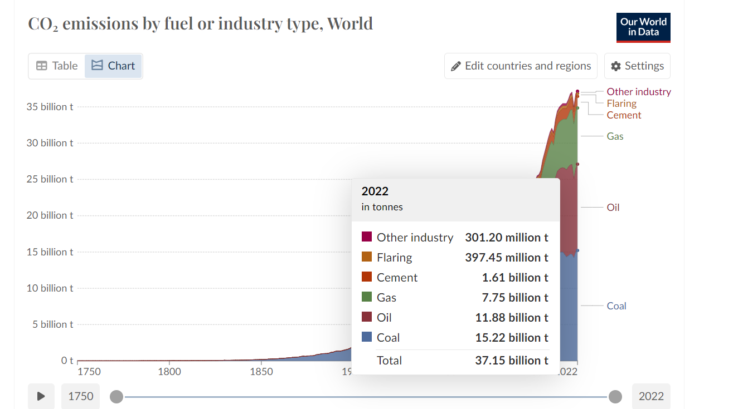
Global greenhouse gas emissions In 2022
53.8
Gt/a CO₂eq
Notes:
https://ourworldindata.org/emissions-by-sector

Slide 5
Global greenhouse gas emissions by Fuel Type In 2022
99.6
Mio. Barrels
/Day
32.0 %
Oil
11.9
37.15
Gt/a CO₂eq
Gt/a CO₂eq
41.0 %
Coal
8.4
Gt/a CO₂eq
20.8 %
Gas
6.2 %
Other

Slide 6
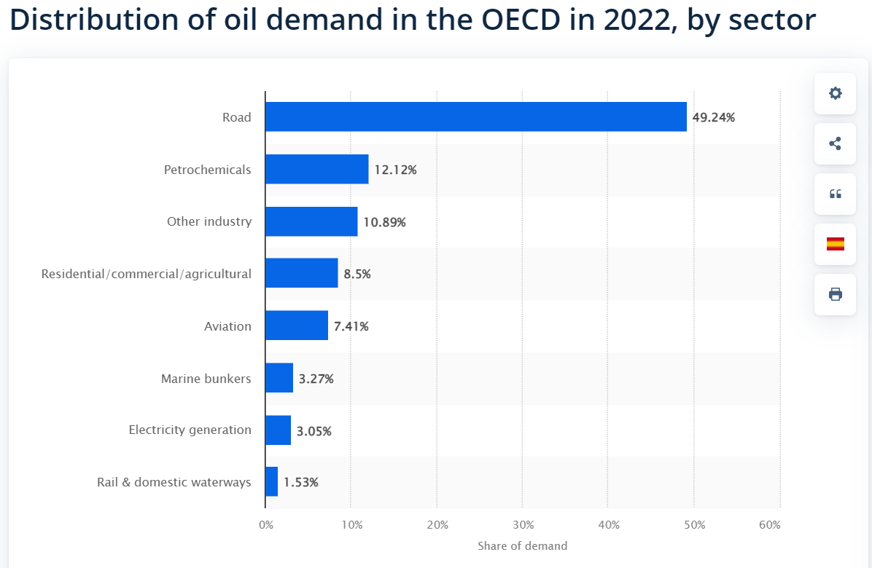
Distribution of oil demand in the OECD in 2022, by sector
12.1 %
Petrochemistry
99.6
Mio. Barrels
/Day
32.0 %
Oil
Other Industrie
11.9
6.2 %
37.15
Gt/a CO₂eq
Gt/a CO₂eq
Residential, Commercial, Agriculture
8.5 %
61.5 %
Transport
41.0 %
Coal
8.4
Gt/a CO₂eq
3 %
Electricity Generation
20.8 %
Gas
6.2 %
Other

Slide 7
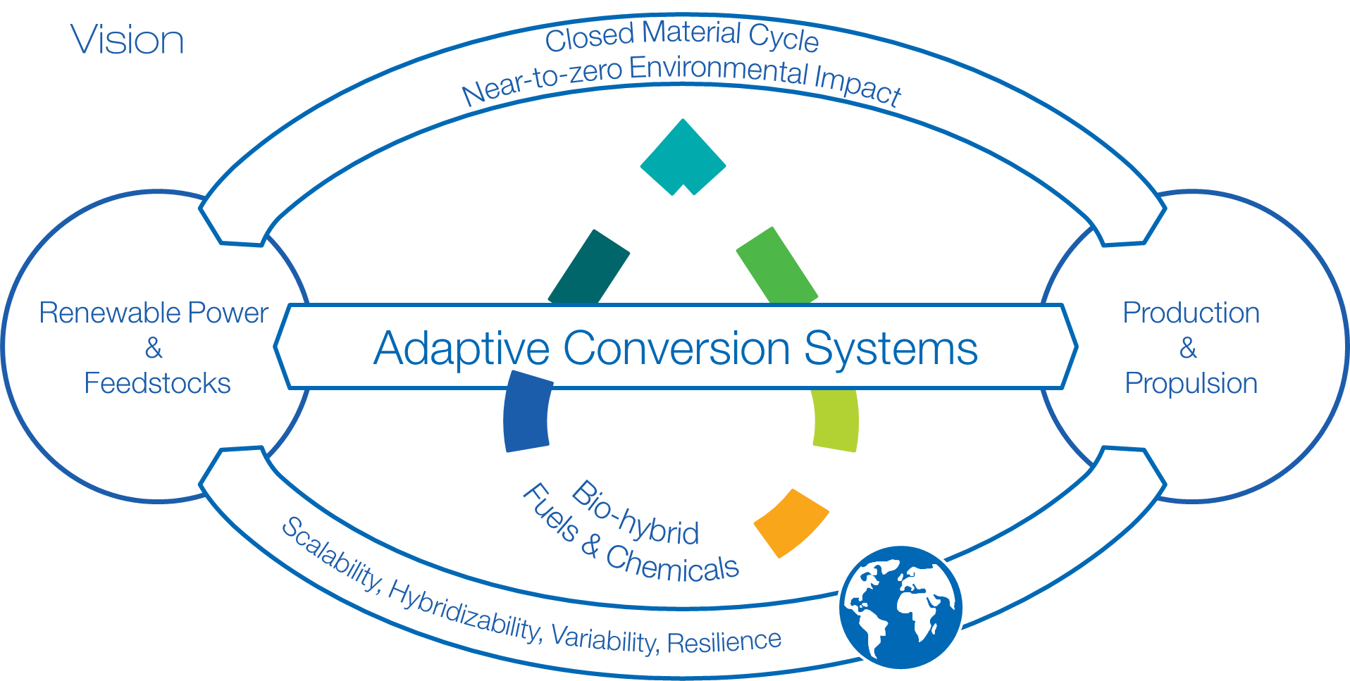
The Integrated Fuel & Chemical Science Center
IAB Meeting | Aachen | 13.06.2024 | confidential

Slide 8
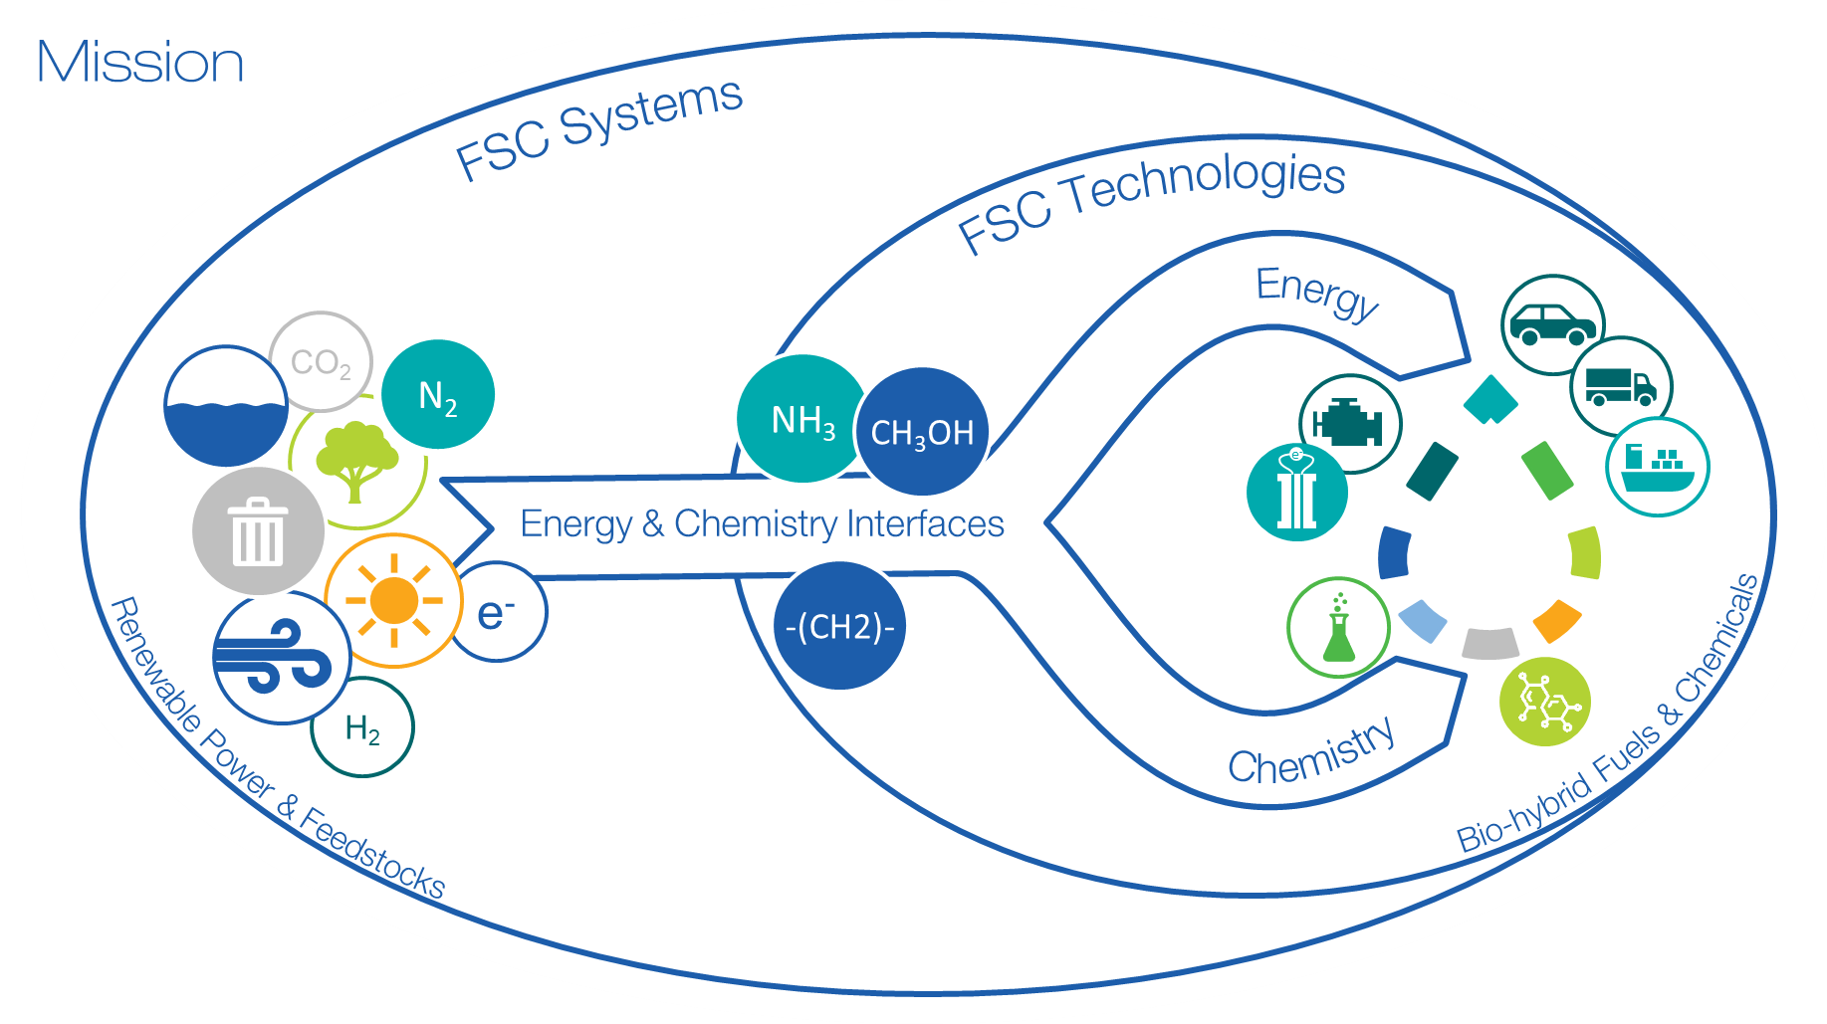

Slide 9
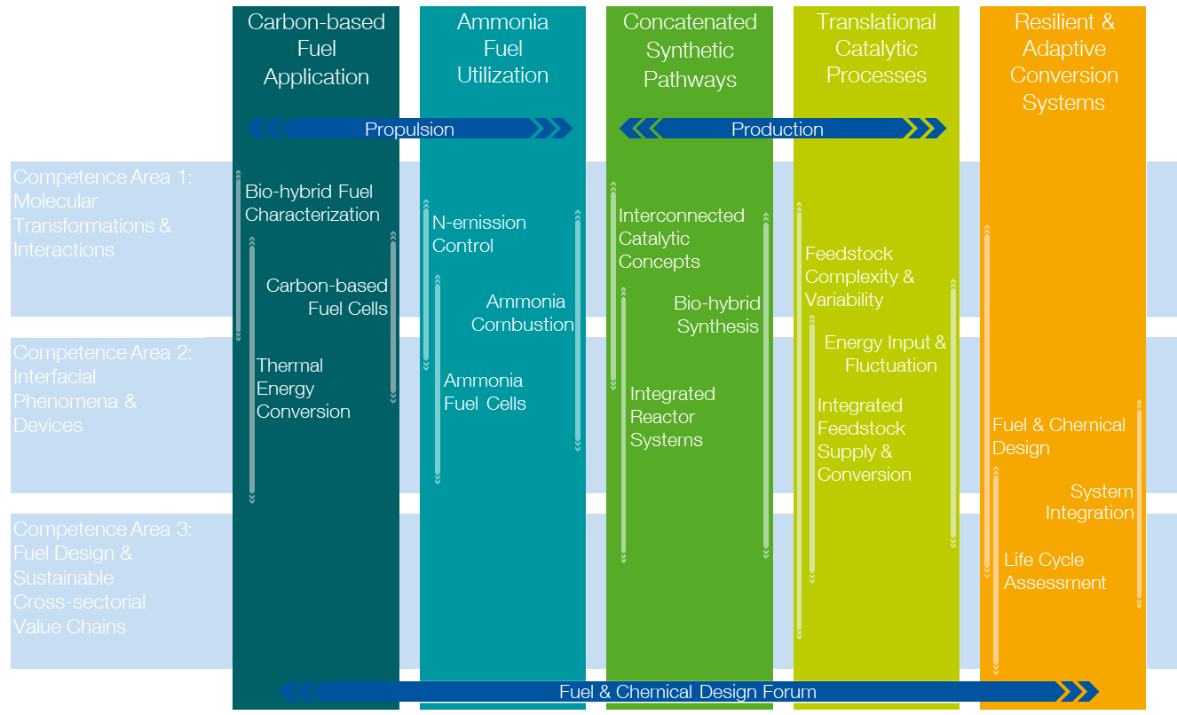
Structure of the Research Program:
Strategic Research Areas Extend Across all Competence Areas

Slide 10
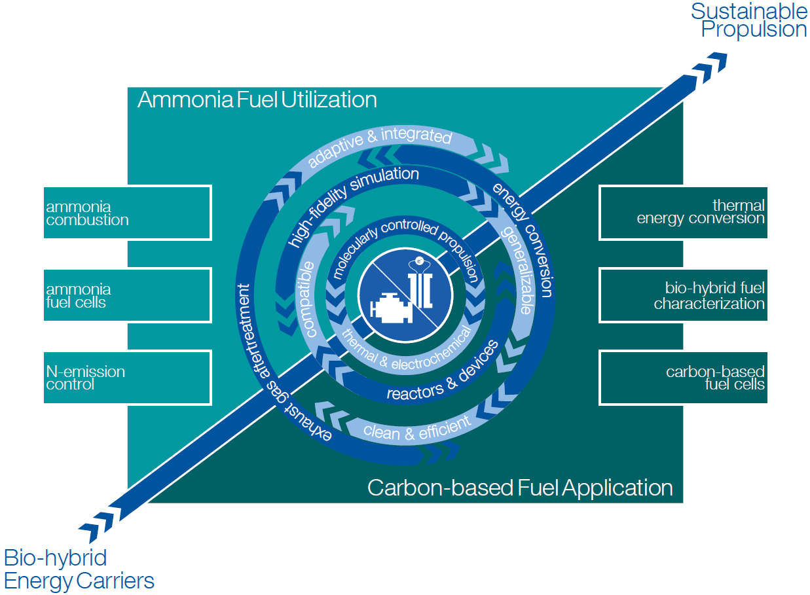
Scientific Objectives - Propulsion
Mitigate carbon emissions from existing vehicle fleet by developing bio-hybrid fuel based molecularly-controlled engine concepts that can be retrofitted to existing combustion systems enabled through advanced technologies for combustion and aftertreatment systems with energy conversion efficiencies beyond 50 % and near-zero pollutant emissions.
Develop carbon- and ammonia-based fuel cell concepts and ammonia-fueled combustion engines for new passenger vehicles, heady-duty, and marine applications enabled by fundamental understanding of the involved thermochemical and electrochemical processes

Slide 11
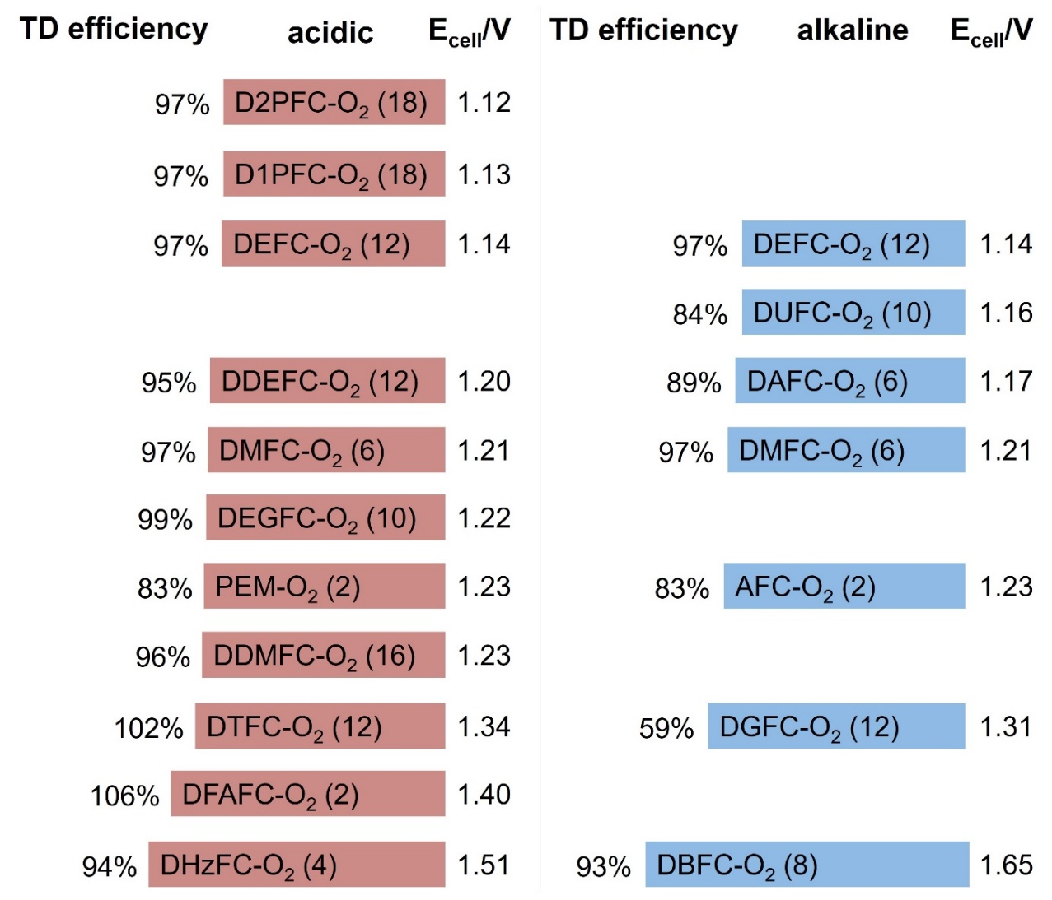
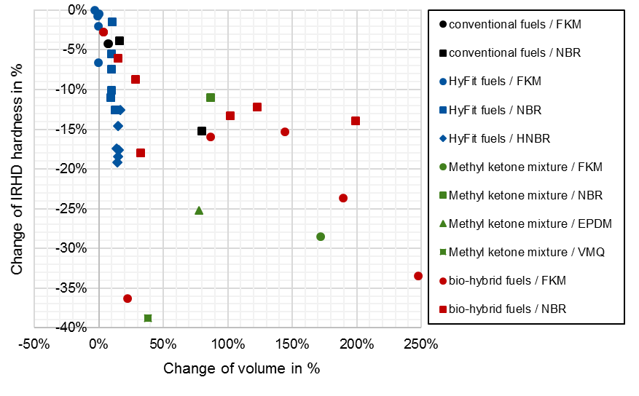
Strategic Research Area I: Carbon-based Fuel Application
Molecularly Controlled Propulsion Systems
Molecularly Controlled Combustion
molecular torch & spark
in-cylinder coating
adaptive exhaust gas aftertreatment
Fuel & Device Compatibility
combustion characteristics
tribology & elastohydrodynamics
long-term behavior
via accelerated testing & simulation
Fuel Cell Technologies
low- & high-temperature
flex-fuel
dynamic operation

Slide 12
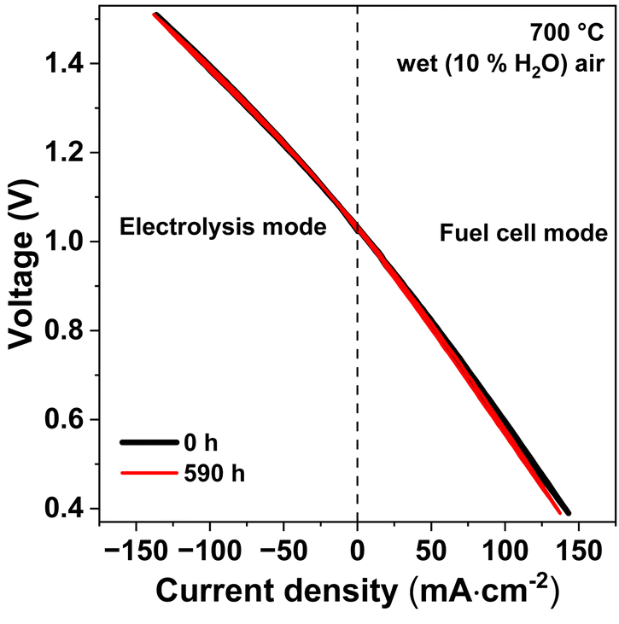
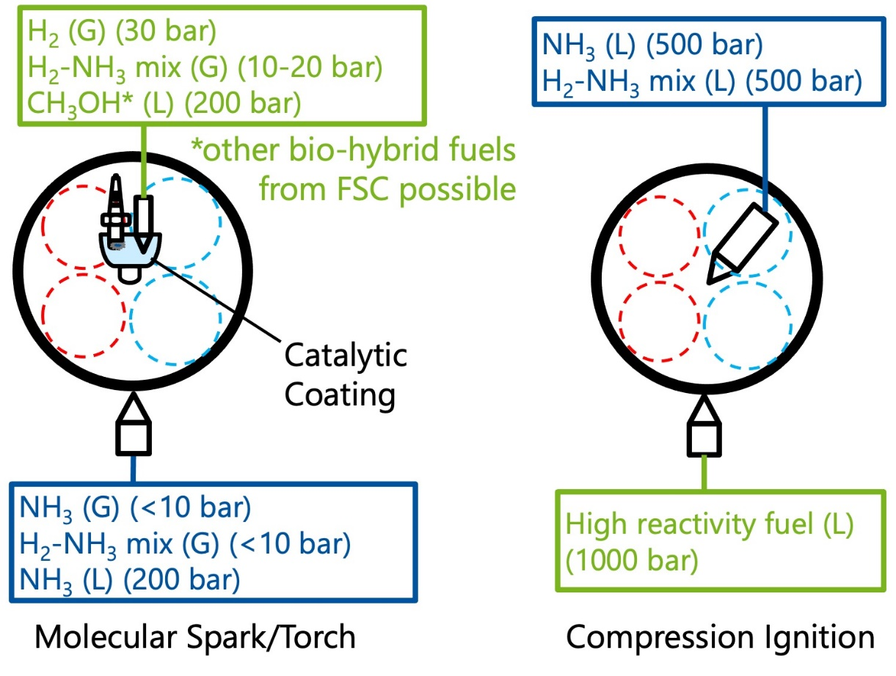
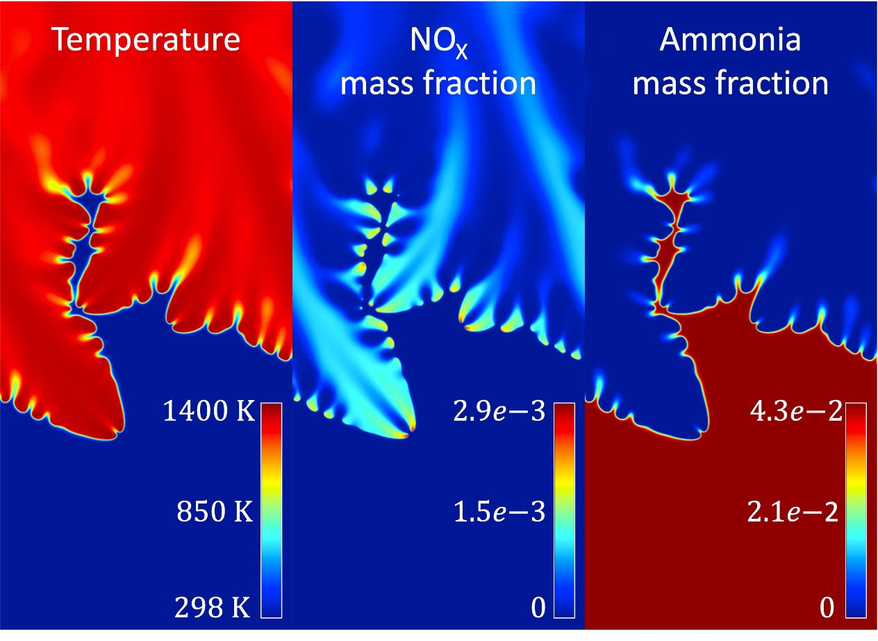
Strategic Research Area II: Ammonia Fuel Utilization
Carbon-free, Clean & Efficient Energy Conversion
Molecularly Controlled Combustion
molecular torch & spark
in-cylinder coating
adaptive exhaust gas aftertreatment
reactivity tailoring
Fuel & Device Compatibility
internal reforming
injection technology
material interaction
Fuel Cell Technologies
low- & high-temperature
proton-conducting SOFC non nobel-metal AOR catalysts

Slide 13
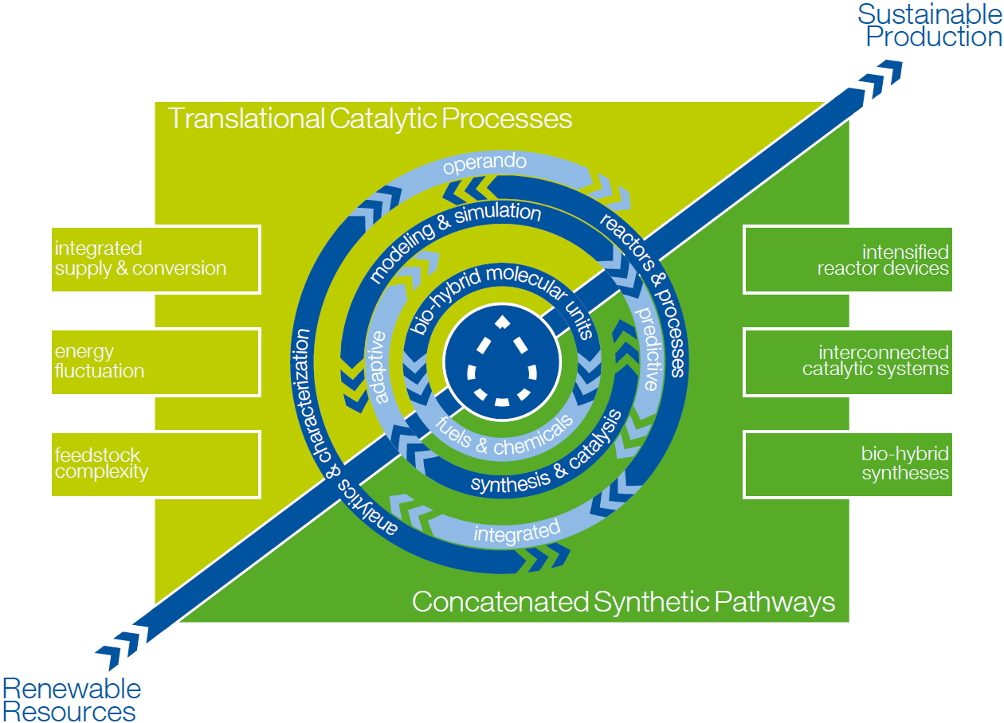
CH₃OH
N₂
NH₃
e⁻
Scientific Objectives - Production
Exploration of chemo-, bio- and electro-catalytic pathways for the selective formation of C-H, C-C, C-O, and C-N bonds from renewable resources with the aim to integrate the individual transformations into optimized synthetic pathways for fuels and chemicals (concatenation) and their validation in view of feedstock variation and energy fluctuation in post-fossil value chains (translation).
Advancing the toolbox in experiment and theory for the investigation of complex catalytic reactions and processes to derive design principles from the molecular to the process level as input for and in response to the interdisciplinary analysis in the Fuel & Chemical Design Forum.
CO₂
e⁻
H₂
-(CH2)-

Slide 14
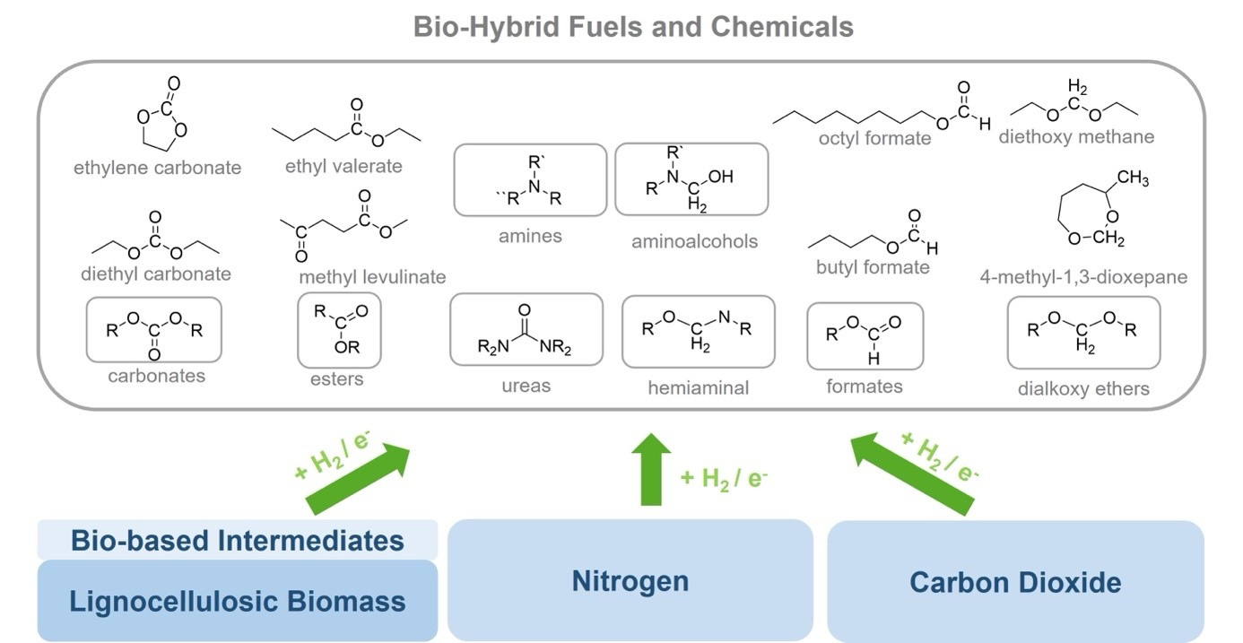
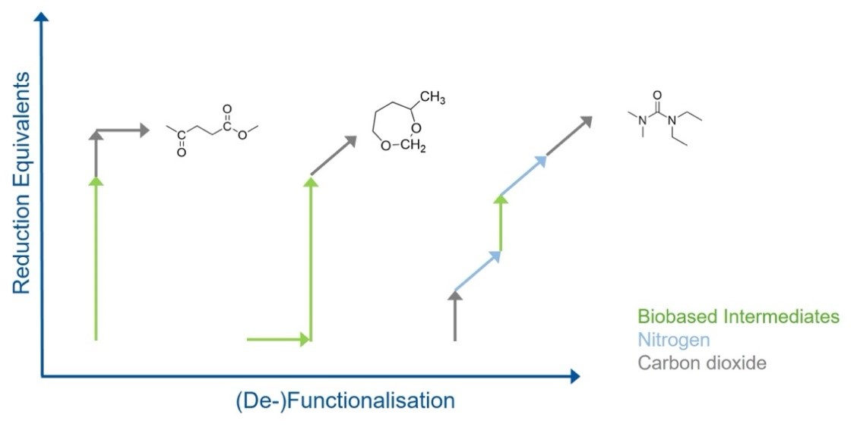
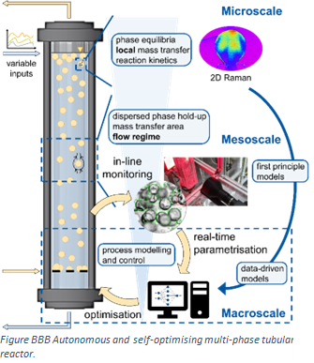
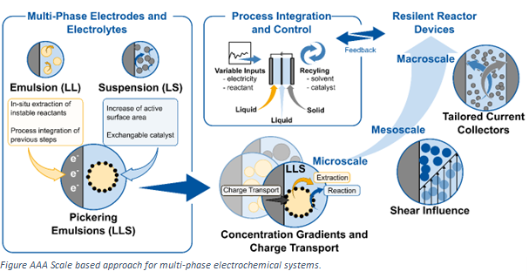
Strategic Research Area III: Concatenated Synthetic Pathways
Catalytic Toolbox to Generate a Flexible Bio-hybrid Molecular Platform
Separation Technologies
distillation phase separation membrane crystallization
Catalyst & Reaction System
activity selectivity stability reaction conditions
Molecular Design
active sites mechanisms local environment

Slide 15
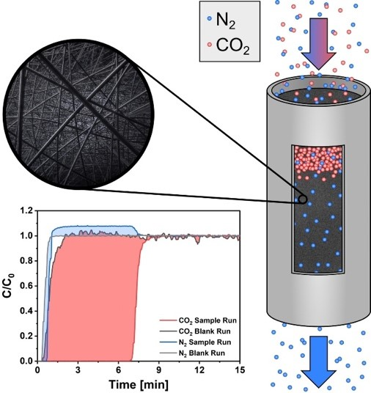
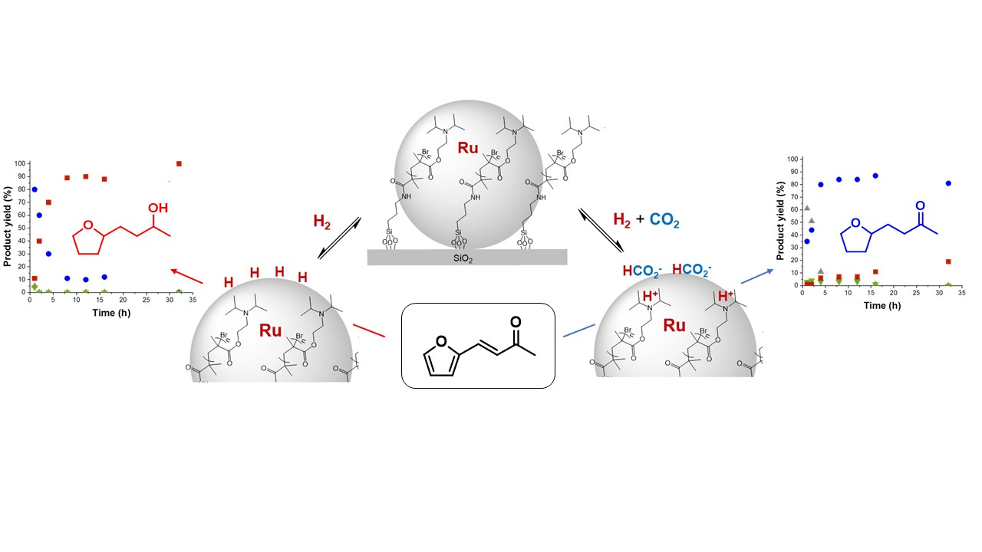
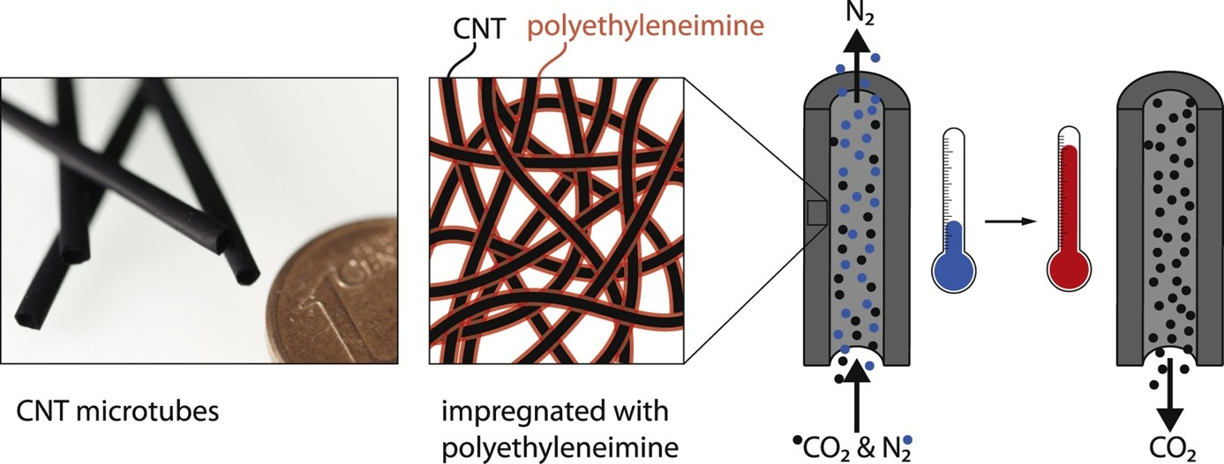
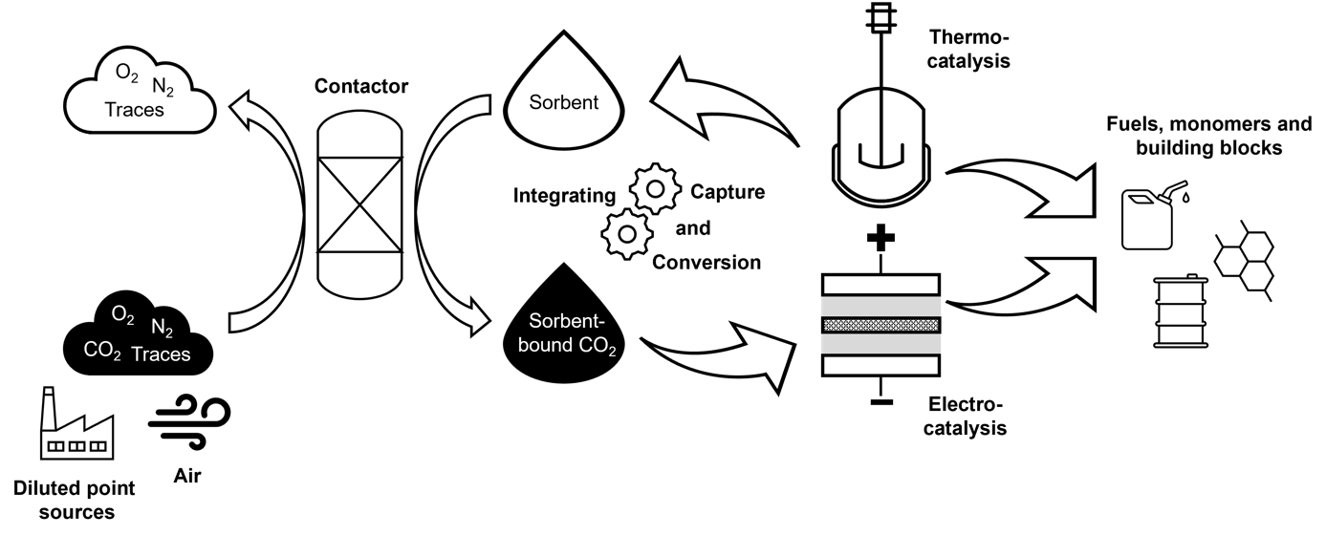
Strategic Research Area IV: Translational Catalytic Processes
Robustness and Stability despite Complex, Fluctuating Feedstocks
Adaptive Catalytic Systems
robust & flexible phase separation membrane crystallization
Raw Material Complexity
catalyst transformation reactor system
Dynamics of Catalytic Systems
operando spectroscopic techniques online kinetic analysis complex phase behavior

Slide 16
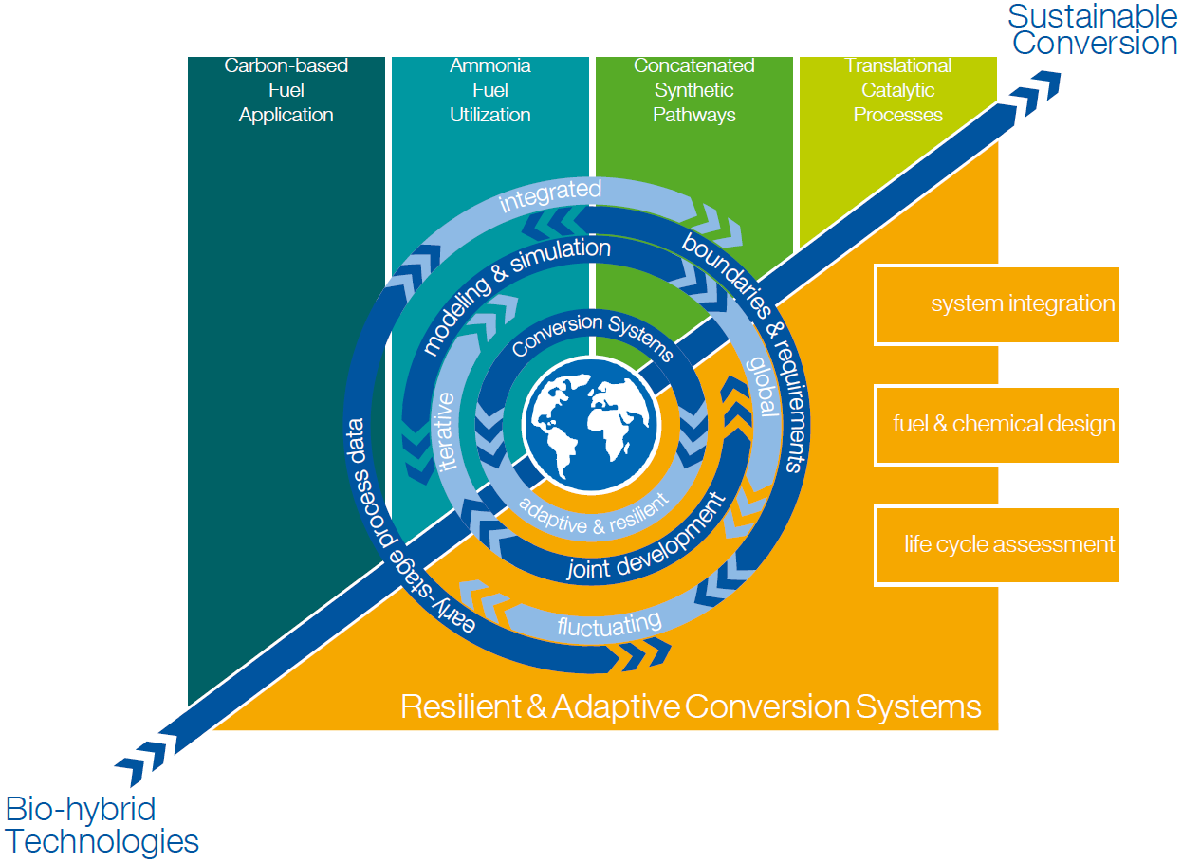
Scientific Objectives - System
System integration of the developed fuels, processes and pathways is enabled by interdisciplinary assessment and optimization of resilient and adaptive intersectoral conversion systems based on systemic risks, stakeholder perspectives, policies and sustainability criteria.
The fuel and chemical design optimizes the overall conversion performance, accounting for fleet-compatible and novel propulsion concepts and co-production of chemicals and fuels; this is done by developing and employing cutting-edge methods from propulsion equipment design, production process development, and machine learning.

Slide 17
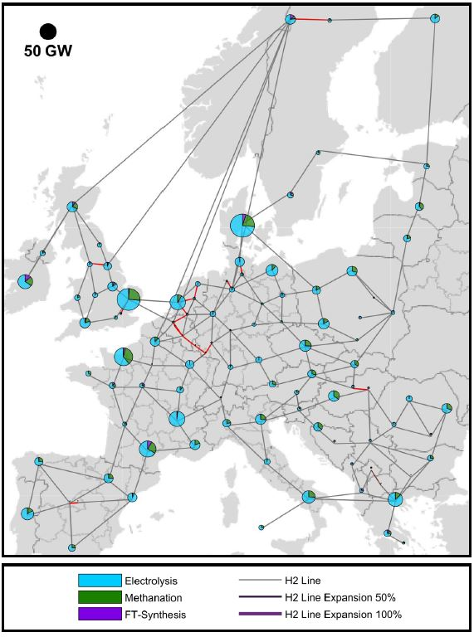
Strategic Research Area V: Resilient & Adaptive Conversion Systems
Resilience and Adaptivity Across Scales
Multisectoral Global Model
robust & flexible phase separation membrane crystallization
Stakeholder Integration
stakeholders’ incentives
policy design
systemic risk measures
Holistic Sustainability
Assessment
environmental social economical

Slide 18
