Slide 1
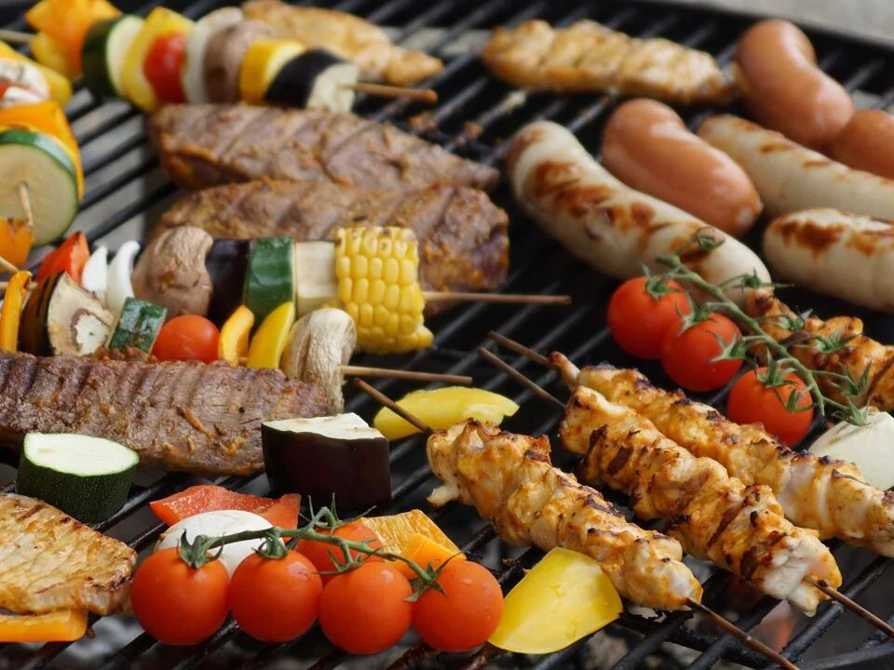
We hereby invite you all to our annual faculty barbecue!
When
July 5th at 6 pm
Where
E.ON ERC barbecue area
Mathieustraße 10,52074 Aachen
Organized by
Institute for Future Energy Consumer Needs and Behavior
Please fill out this survey to register for the event no later than June 7th
Click here to register
Please transfer the all-inclusive fee of 12 € no later than June 7th. This will be used to provide you with delicious eats and cold drinks!
Jakob Kulawik
IBAN: DE70120300001051518643
Paypal:jakob.kulawik@googlemail.com

